Slide 1
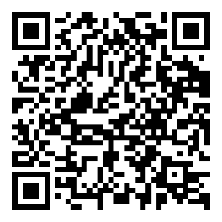
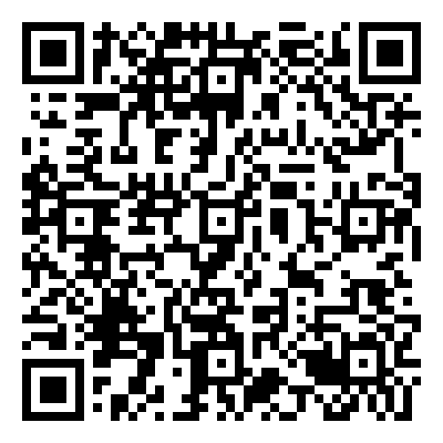
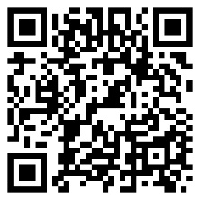
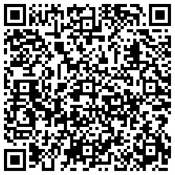
Ryegate Motor Skills Team
School Age Children
Multi-disciplinary team consisting of occupational therapists (OT), physiotherapists (PT) and therapy support workers.
Aim: to help children develop their motor skills and up skill parents to teach and support skills.
We can help with:
Fine motor skills e.g. buttons, shoelaces, cutlery, washing, wiping, handwriting.
Gross motor skills e.g. throwing and catching, bike riding, swimming.
Assessment for DCD (Developmental Coordination Disorder/Dyspraxia).
Universal
Targeted
Children referred by health professional.
Specialist
Handwriting advice available on Learn Sheffield.
Independence skills videos available on The Motor Skills Team and ‘Watch me do it’ websites.
Families request further support.
Families directed to online virtual therapy area.
Independence skills clinic – up to three 1:1 sessions led by therapy assistants.
Families request further support.
Motor skills pathway or DCD diagnostic pathway.
Assessment of motor skills with therapist.
Goal setting, individual or group therapy sessions.
Motor Skills Team
Independence Skills
‘Watch me do it’
Handwriting Advice

Slide 2
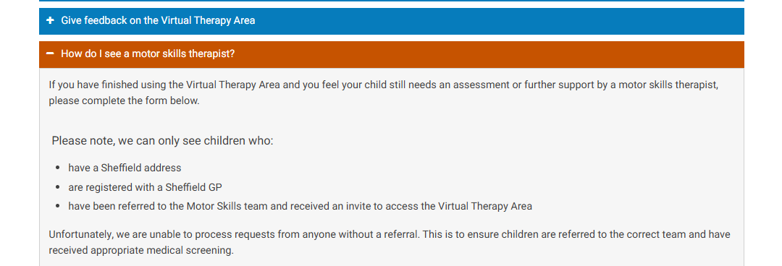
Working with schools
How schools can help
Referrals: from a medical professional e.g. GP
We really value support letters from schools. Please tell us about:
The child's difficulties in school e.g. dressing, PE, handwriting.
Is there a learning delay, if so, state it in YEARS not school scales e.g. B-ham Tool Kit or ARE.
What additional support is already in place?
Consider is it motor skills difficulties or poor attention and impulsivity?
Universal
Use guidance in handwriting resources on Learn Sheffield website.
Targeted
Deliver interventions to help handwriting difficulties.
Specialist
Complete motor skills questionnaire when requested.
Sign post families to independence skills videos.
Read motor skills assessment reports or discharge summaries for on going recommendations.
Contact the allocated therapist for specific advice if needed.
Help parents access the virtual therapy area and request support if needed online (within 6 wks of receiving letter).
Identify children with motor skill difficulties, write a supporting letter for parents to take to their GP.
Support parents to request further support on the virtual therapy area:

