Slide 1
Stephen Betts
(CEO - Learn Sheffield)
Sheffield Schools Forum
Thursday 22nd September 2016

Slide 2
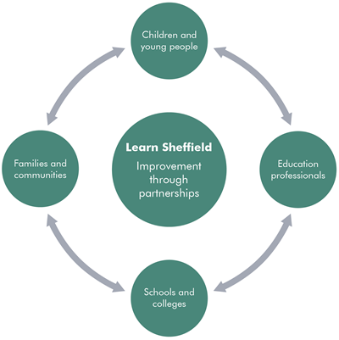
Learn Sheffield
Not for profit Schools Company (80% owned by schools/colleges & 20% owned by SCC)
Membership includes all sectors and types of publically funded education – currently 95%+ joined or indicated intention to join
Purpose – school improvement
Belief – improvement through partnership (school-led system)
Strategic vision – takes a wide view of improvement – reflected in the Sheffield Priorities
Services to schools being developed – partly linked to the internal SCC review of existing services – in a changing financial & funding environment.

Slide 3
Understanding the Challenge – The Gap in the Government’s ‘Plan’
“ Nobody really has a clear remit for all the schools in an area – RSCs are required to focus primarily on dealing with failure in both the maintained and academy sectors.”
Robert Hill
(November, 2015)
Structural change has created a “very fragmented school system” where those who do lead school improvement … “rely on soft influence and the shared moral purpose of local headteachers to develop local solutions.”
In some areas nobody is “… seeking to play any significant school improvement role.” This is reinforced by the government’s drive to remove LAs from playing any role in school improvement.
Several risks arise from this scenario - including the danger of some schools being isolated and left behind outside the MAT system or in “MATs of last resort”.

Slide 4
Understanding the Challenge – The Gap in the Government’s ‘Plan’
“ Nobody really has a clear remit for all the schools in an area – RSCs are required to focus primarily on dealing with failure in both the maintained and academy sectors.”
Robert Hill
(November, 2015)
Robert Hill makes the case for a board or commissioner to fulfil this absent co-ordinating role, working ‘with and through’ others. He argues that “The arrangements might look quite different in different parts of the country but school improvement should draw on the principles of the Challenge-style programmes and, compared to the existing RSC regions, be organised on a smaller scale but with a bigger remit.”
This is the case for Learn Sheffield and for having both a new School Improvement Strategy and the wider focus of the Sheffield Priorities work.

Slide 5
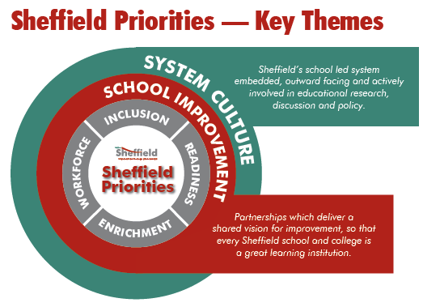
Purpose of education – better life chances …
achievement (opens doors)
& readiness (to walk through those doors)

Slide 6
Sheffield has already created the platform to deliver school improvement in the current context by creating Learn Sheffield …
+
Wide ranging and longer term action planning to overcome substantial barriers to school improvement.
Tightly focussed strategy to ensure that Learn Sheffield resources are targeted to have the maximum impact.
… which has the platform to develop the education system that the city needs to fulfil its ambitions.

Slide 7
Future Challenges
How do we build on a successful collaborative approach in a challenging national context?
Key Challenges:
Dynamic policy environment – grammar schools, funding reform, school autonomy, etc.
Financial pressure – Local Government & school budgets
Increased difficulty in funding collaborative working systematically
Current Approach:
LA Commission – beginning of year two of three
Beginning to develop/consider services – supports objectives, develops organisational capacity & financial stability (e.g. turnover rather than surplus).
This is a strong platform – Sheffield ‘ahead of the game’.

Slide 8
Future Challenges
How do we build on a successful collaborative approach in a challenging national context?
Next Steps:
Consider different approaches to collaboratively funding key areas of work
- consider the shift in delegation of funding
- consider the duties and objectives of Local Government
- consider any opportunities for collaborative funding
Secure additional funding streams – bids, commissions, bonds, etc.
Future discussion:
Collaborative funding arrangements
This is a strong platform – Sheffield ‘ahead of the game’.

