Slide 1
Welcome to Learn Sheffield
Please Note
Refreshments are in the Comfort Zone.
The fire exits are the main entrance and at the rear of the building (at the end of the corridor containing the toilets).
No fire drills are planned to take place during this session.
This briefing is being filmed so that it can be viewed by colleagues who are not able to be here.
The slides from today, any handouts referred to, brief notes and the link to access the recording will be emailed out as soon as possible.

Slide 2
Briefing Agenda (15th December, 2015)
Introduction / Launch of ‘Primary Opportunities’
Learn Sheffield Update - Sheffield Priorities Project & Learn Sheffield School Improvement Offer
National Leaders of Governance
College of Teaching
Primary Leaders Conference 2016
PLP Update
9:30am Key Note Speaker – Will Emms (Standards & Testing Agency)

Slide 3
Briefing Agenda (15th December, 2015)
Introduction / Launch of ‘Primary Opportunities’
Learn Sheffield Update - Sheffield Priorities Project & Learn Sheffield School Improvement Offer
National Leaders of Governance
College of Teaching
Primary Leaders Conference 2016
PLP Update
9:30am Key Note Speaker – Will Emms (Standards & Testing Agency)

Slide 4
Learn Sheffield Update - Stephen Betts
Sheffield Priorities Project
Learn Sheffield School Improvement Offer
Commissioned Opportunities
Sheffield School Improvement Strategy 2016-2018
Key Spring Term Dates

Slide 5
Learn Sheffield Update – Sheffield Priorities Project
Learn Sheffield is considering what its key priorities should be, as part of the development of the Sheffield School Improvement Strategy (January 2016- July 2018).
What are the barriers to school improvement in Sheffield?
Working with Marc Rowland (National Education Trust) to identify the objectives, action plan and monitor outcomes.
Phase 1 - Four days of workshops (December/January)
Phase 2 – Action Planning (February)
Phase 3 – Consultation (March – up to end of Spring term)

Slide 6
Learn Sheffield Update – School Improvement Offer
Learn Sheffield ‘Primary School Improvement Offer’ will be out ready for the start of the Spring Term.
Range of review & self evaluation activities.
Quality Assured ‘external perspective’ to feed into school self-evaluation and development planning.
Written feedback (when chosen) provides independent evidence.
There will be indicative pricing but schools should approach us so that the activities can be tailored.
There will be discounts for groups of schools.

Slide 7
Learn Sheffield Update – Commissioned Opportunities
In January the website will have a page for commissioned opportunities, with any providers able to sign up for email updates of new commissions.
In the meantime the opportunities below will be emailed out this week.
Sheffield School looking to second two teachers
Associate Learn Sheffield Improvement Partners
EAL Assessment Pilot – 10 Schools

Slide 8

Sheffield School Improvement
Strategy 2016-2018
Currently being drafted.
Underpinned by the work happening with each sector.
Out for consultation during later part of Spring 1.

Slide 9
Learn Sheffield Update – Key Dates (Spring 1)
Thurs 7 Jan – Additional PLP session with Marc Rowland (Priorities Project)
Fri 8 Jan – IT Innovation Session @ Learn Sheffield
Mon 18 Jan – Priorities Project Open School Leaders Session (2:30pm)
Thurs 21 Jan – PLP Meeting
Wed 27 & Fri 29 Jan – Additional Prevent Training Sessions (both AM)
Fri 29 Jan - Priorities Project Open School Leaders Session (2:30pm)
Wed 3 Feb – Primary Briefing (8:30am @ Learn Sheffield)
(Note – Spring 2 Primary Briefing has also moved to a Wednesday - 16th March)

Slide 10
Briefing Agenda (15th December, 2015)
Introduction / Launch of ‘Primary Opportunities’
Learn Sheffield Update - Sheffield Priorities Project & Learn Sheffield School Improvement Offer
National Leaders of Governance
College of Teaching
Primary Leaders Conference 2016
PLP Update
9:30am Key Note Speaker – Will Emms (Standards & Testing Agency)

Slide 11
National Leaders of Governance
Andy Childs & Derek Grover

Slide 12
Briefing Agenda (15th December, 2015)
Introduction / Launch of ‘Primary Opportunities’
Learn Sheffield Update - Sheffield Priorities Project & Learn Sheffield School Improvement Offer
National Leaders of Governance
College of Teaching
Primary Leaders Conference 2016
PLP Update
9:30am Key Note Speaker – Will Emms (Standards & Testing Agency)

Slide 13


College of Teaching
A chartered professional body to raise the status of teaching

Slide 14

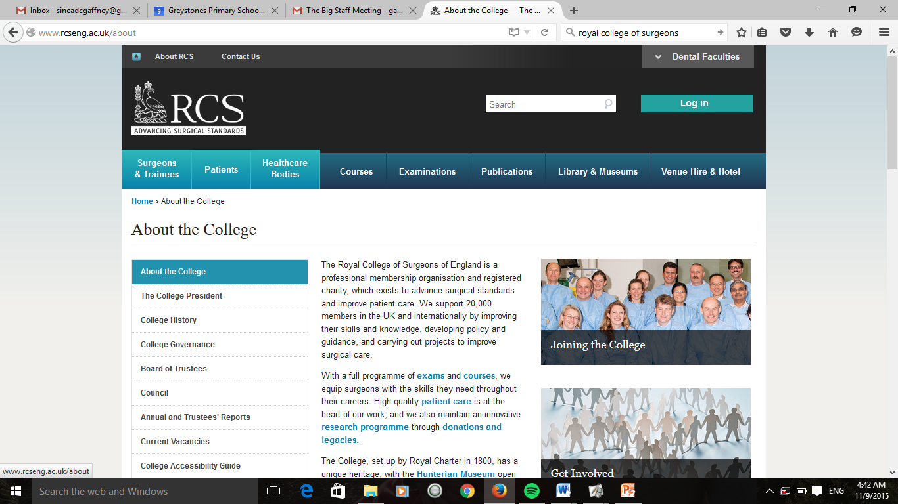


A Royal Charter is a guarantee of independence and autonomy.
It gives a professional association the rights, in perpetuity, to recognise achievement and set standards for the profession.

Slide 15
A CoT…
… will champion high standards in teaching. It will articulate profession-led
standards of practice in five key areas – subject content; pedagogical knowledge; professional
skills; contribution to the profession; and leadership.
…will support the development of teaching as a research-informed and
engaged practice, to help teachers make good professional decisions in the classroom.
… have professional development as its core purpose, championing high
standards of support for teachers by providing support and guidance for professional
development and a platform to evaluate and record professional learning.
… will offer equality of status with other chartered professions, giving
teachers greater confidence and independence - reducing ineffective interventions, policy
and practice.

Slide 16
I’m in favour of a College of Teaching because it offers something we lack and need…..
The absence of such a body has resulted in governments defining professional practice over the years, disempowering the profession and affecting standards of teaching.
We have somehow allowed ourselves to become a fractured profession with those at the chalkface ending up with the most diminished voices.
David Weston
The College of Teaching will develop as a member-driven and voluntary professional body run by teachers for teachers in order to best meet the needs of the profession. The College will be independent – free from political influence – and will work closely and collaboratively with others in the sector.

Slide 17


Slide 18


Slide 19
Briefing Agenda (15th December, 2015)
Introduction / Launch of ‘Primary Opportunities’
Learn Sheffield Update - Sheffield Priorities Project & Learn Sheffield School Improvement Offer
National Leaders of Governance
College of Teaching
Primary Leaders Conference 2016
PLP Update
9:30am Key Note Speaker – Will Emms (Standards & Testing Agency)

Slide 20
Primary Leaders Conference 2016 – Nicola Shipman
Thursday 16th & Friday 17th June 2016
Holiday Inn, Barnsley (Junction 37)
Options – 2 day / 1 day … residential / non-residential
Keynote Speakers – Andy Cope, Stephen Tierney (@leading learner), Neil Griffiths, Olivier Mythodrama, plus local showcases.
Booking Form & Costings out in the new year

Slide 21
Briefing Agenda (15th December, 2015)
Introduction / Launch of ‘Primary Opportunities’
Learn Sheffield Update - Sheffield Priorities Project & Learn Sheffield School Improvement Offer
National Leaders of Governance
College of Teaching
Primary Leaders Conference 2016
PLP Update
9:30am Key Note Speaker – Will Emms (Standards & Testing Agency)

Slide 22
Primary Leaders Partnership Update
– Paul Stockley (PLP Chair)

Slide 23
Briefing Agenda (15th December, 2015)
Introduction / Launch of ‘Primary Opportunities’
Learn Sheffield Update - Sheffield Priorities Project & Learn Sheffield School Improvement Offer
National Leaders of Governance
College of Teaching
Primary Leaders Conference 2016
PLP Update
9:30am Key Note Speaker – Will Emms (Standards & Testing Agency)

