Slide 1
My Family – a lesson pack from Stonewall
Reception – England and Wales
P1 - Scotland
Notes:
Visit our website for the lesson plan to accompany this PowerPoint.

Slide 2
LO: To be able to talk about my family
Notes:
As a class, read The Family Book by Todd Parr. Discuss the different types of family, including families with same gender parents, foster families and adoptive families

Slide 3
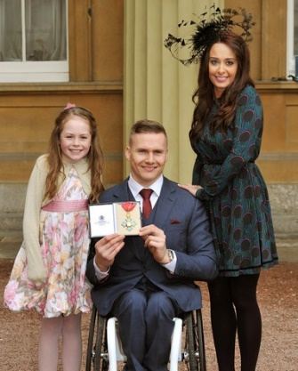
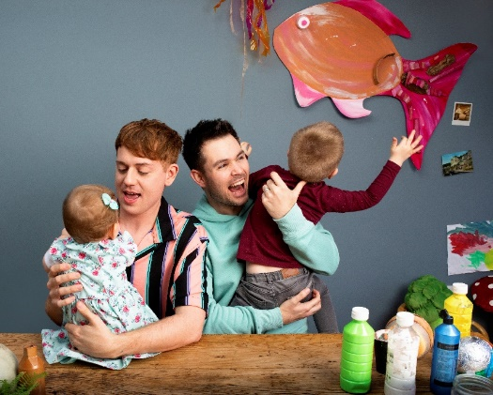
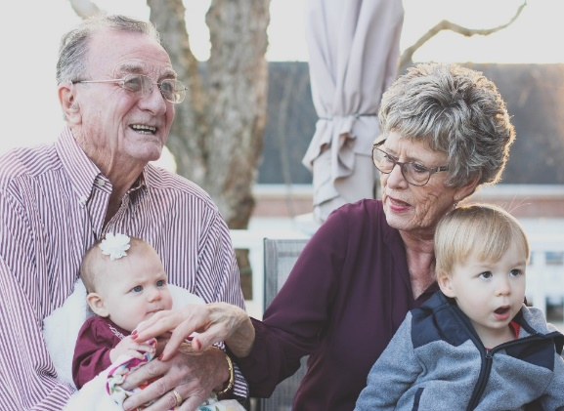
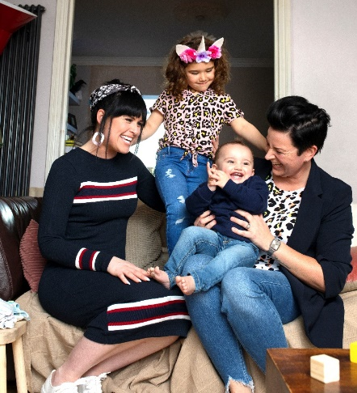
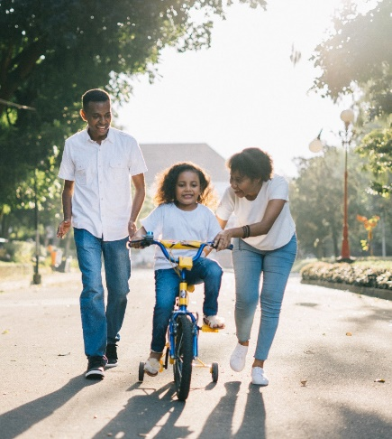
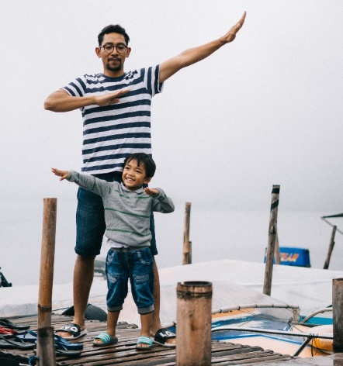
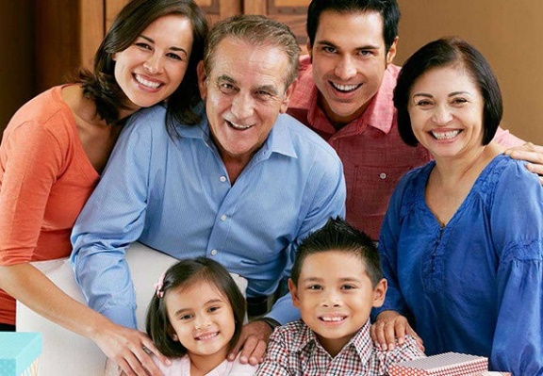
LO: To be able to talk about my family
Who is in these families?
Notes:
Who are the people in these different families?

Slide 4
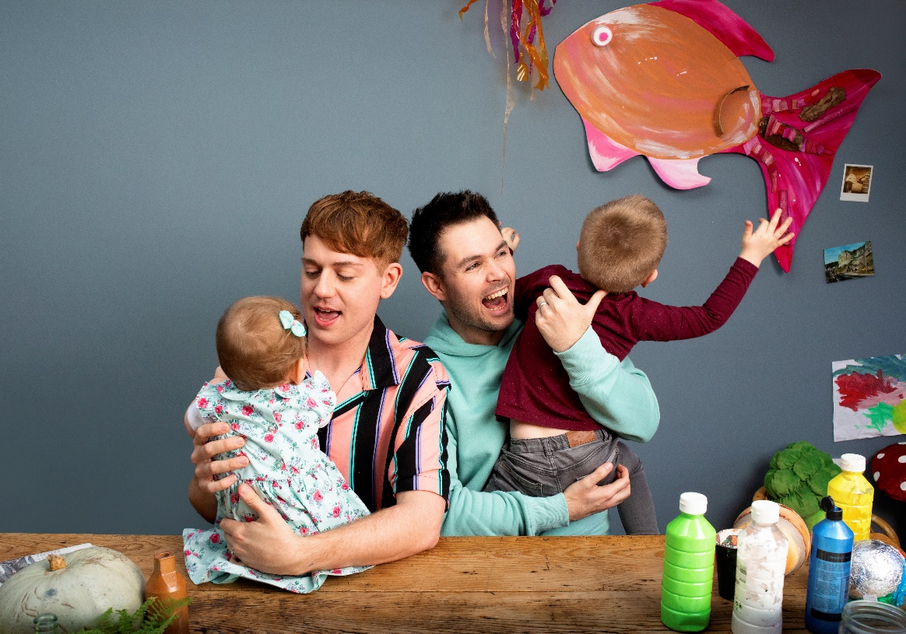
LO: To be able to talk about my family
Who is in your family?
Notes:
Use the book and the Family Portraits PowerPoint as a stimulus for children to discuss their families with a partner and then as a class.

Slide 5
LO: To be able to talk about my family
Make a family portrait
Make your family out of play dough
Write the names of the people in your family on paper
Put the names next to your play dough people
Take a photo of your family portrait
Notes:
Ask children: What does family mean to you? Children use play dough to create a 3D family portrait. They should make their family members out of play dough.
Children can write the names of their family members on slips of paper in order to label the family portrait.

Slide 6
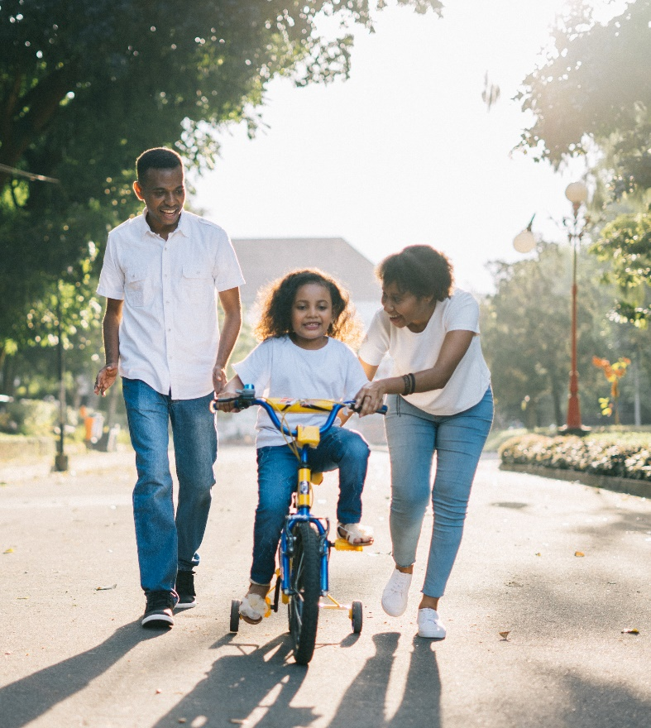
LO: To be able to talk about my family
Who is in our families?
Notes:
As a class, look around the class gallery of 3D family portraits, give children the opportunity to share about their families – make sure that a diverse range of families are discussed.

