Slide 1
Relationships – lesson pack from Stonewall
To take part in a sensory story AND To look at pictures of different couples
To answer questions about a story AND To know that a romantic relationship can be between people of any gender
To talk about events in a story and link them to my own experiences AND To understand that a romantic relationship can be between people of any gender
Notes:
Visit our website for the lesson plan and worksheet to accompany this PowerPoint.

Slide 2
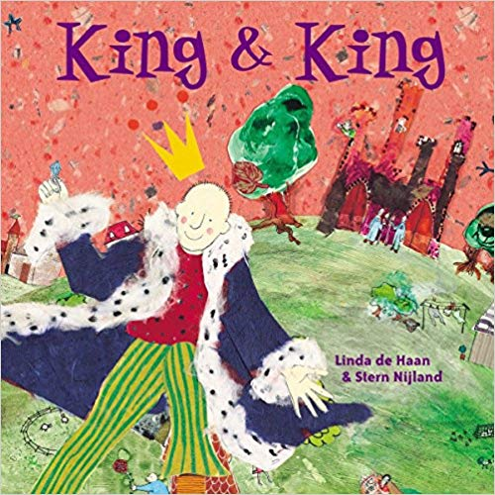
King and King
2
Notes:
As a class, read King and King. Use the sensory props to support understanding and engagement.

Slide 3
Who got married?
The princes
3
Notes:
Who got married in the story? Students to answer if they are able to, or match key symbols

Slide 4
Why did they get married?
Love
4
Notes:
Why did the two princes get married? Students to answer if they are able to, or match key symbols

Slide 5
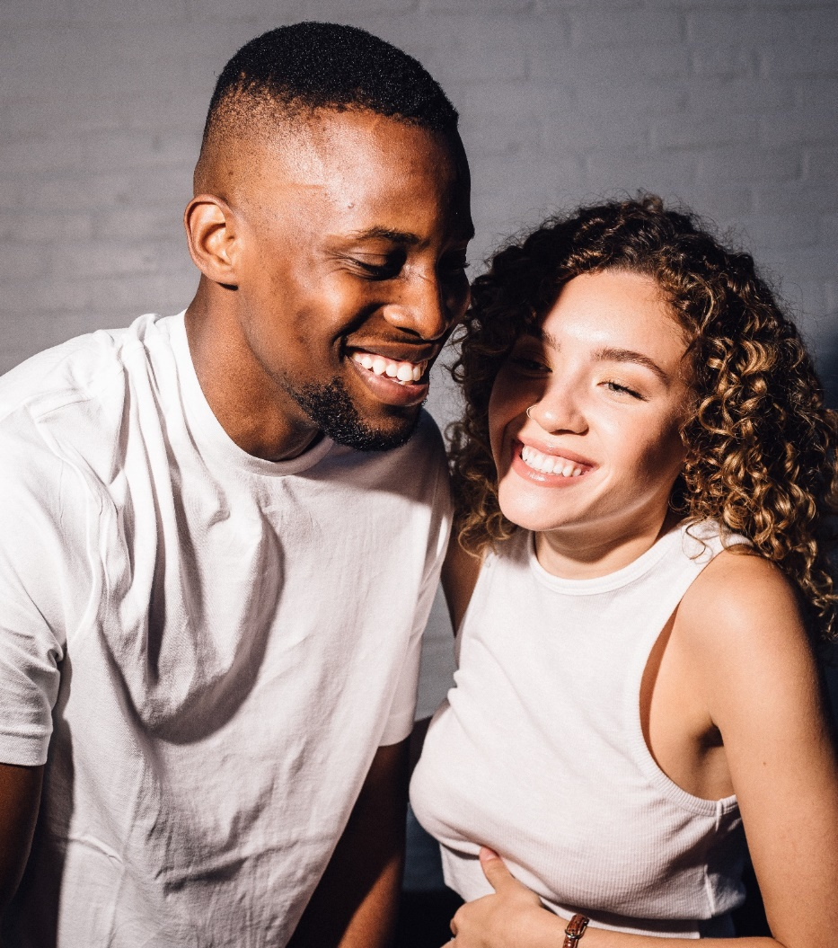
5
Notes:
Look at the photos of the different couples. Discuss that the photos show people who are married or in a relationship with each other. They are people that are in love with each other.

Slide 6
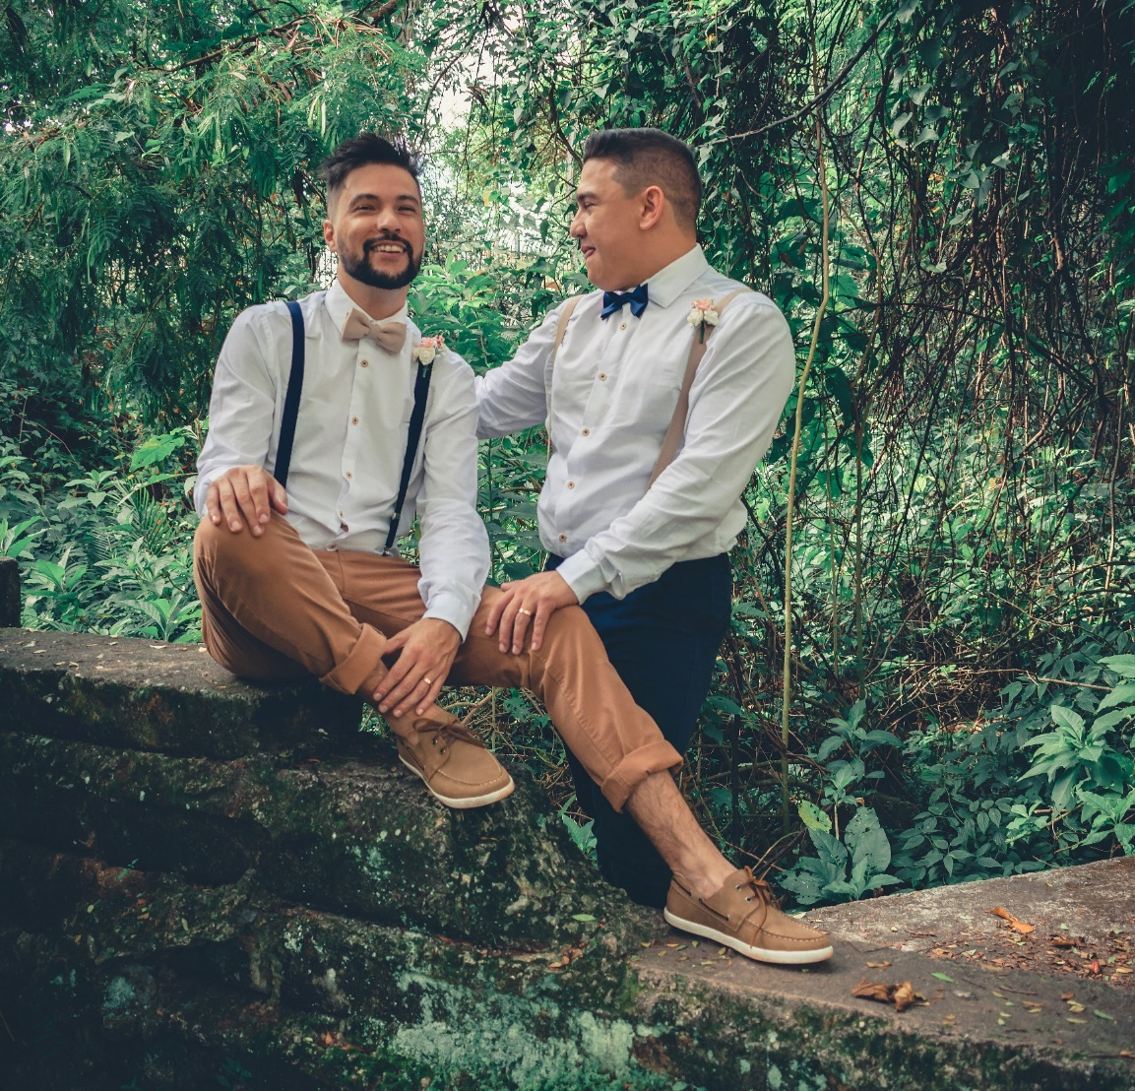
6
Notes:
Look at the photos of the different couples. Discuss that the photos show people who are married or in a relationship with each other. They are people that are in love with each other.

Slide 7
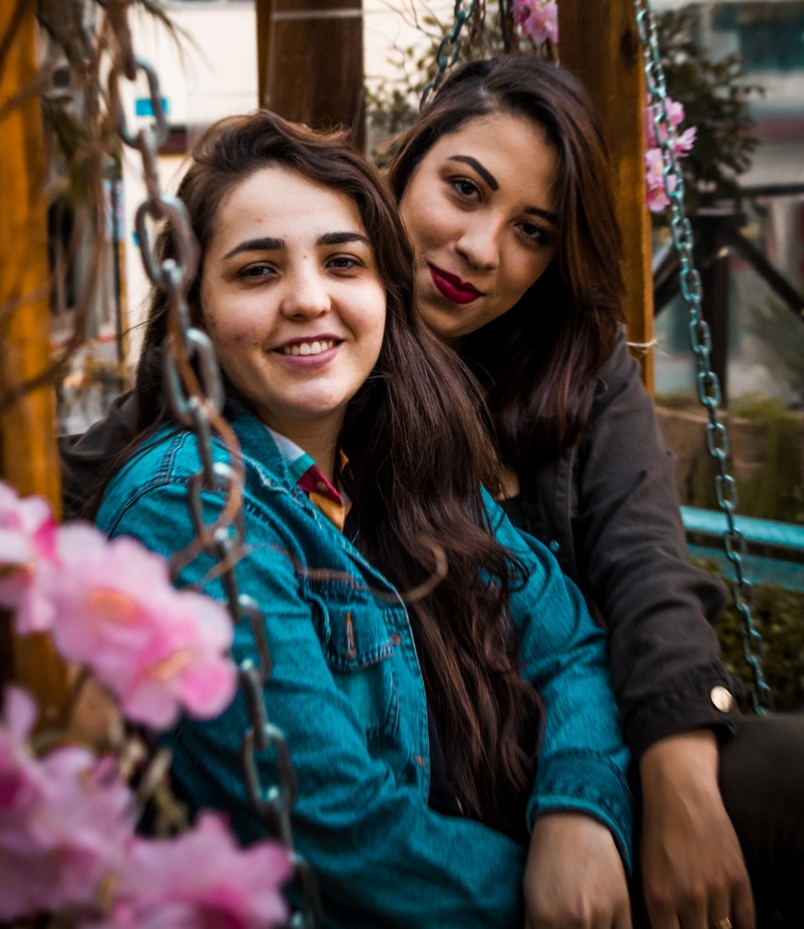
7
Notes:
Look at the photos of the different couples. Discuss that the photos show people who are married or in a relationship with each other. They are people that are in love with each other.

Slide 8
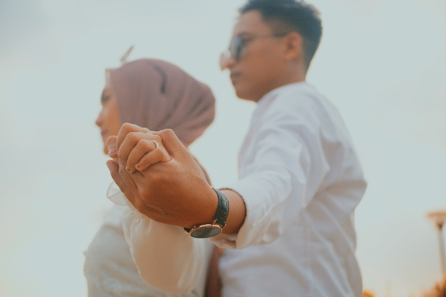
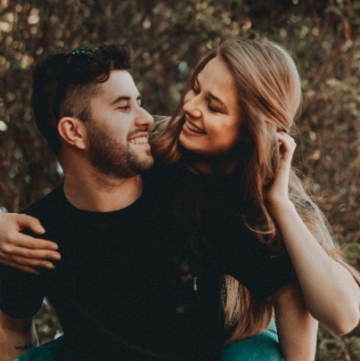
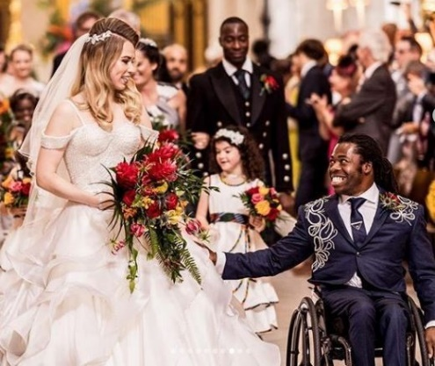
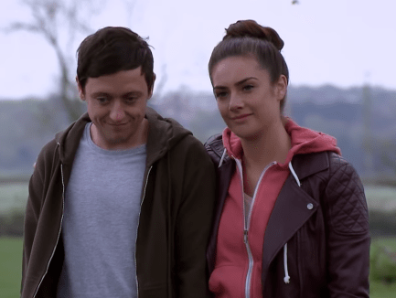
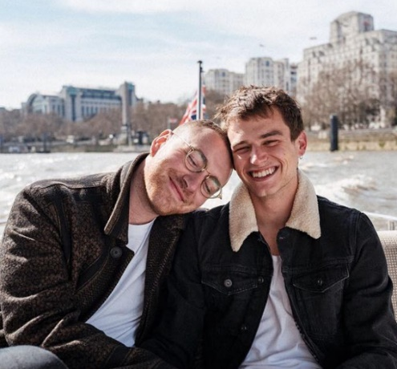
Different gender couples
8
Notes:
Explain that some people have a relationship with people of a different gender to them. This includes if one of the people in the relationship is non-binary, like Sam Smith (bottom right)

Slide 9
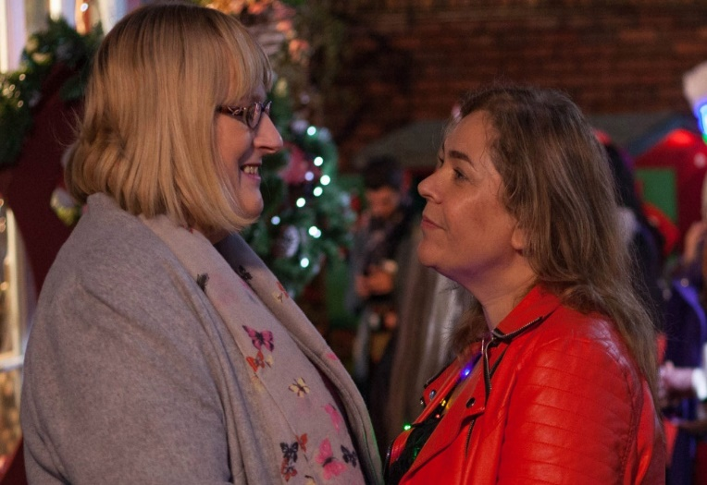
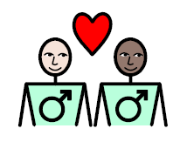
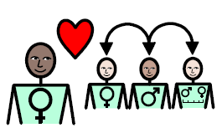
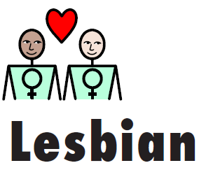
Same gender couples
9
Notes:
Explain that some people are gay, lesbian or bi. Lesbian and gay people are attracted to people of the same gender as them.

Slide 10
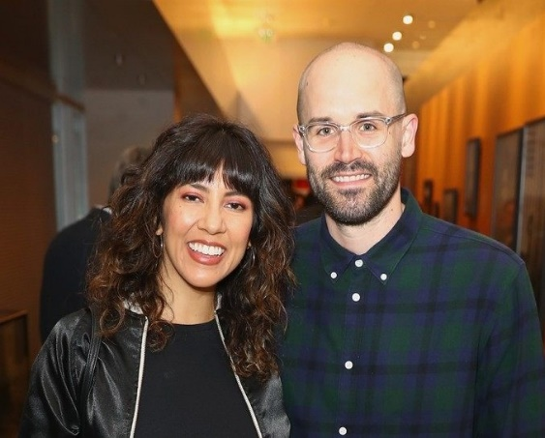
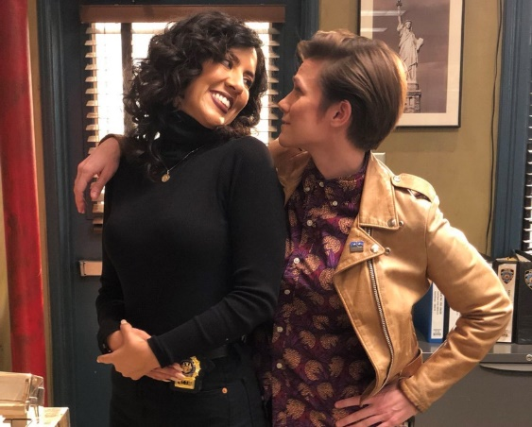
Some people are bi.
Bi people love men.
Bi people love women.
Bi people love non-binary people.
LGBT
10
Notes:
Explain the word bi and reiterate that some people don’t mind which gender their partner is.

Slide 11
Make a poster about relationships
11
Notes:
Students create a poster about relationships, choose an activity as appropriate:
• Students stick pictures of different couples onto an A3 piece of paper and stick on or match symbols relating to different types of couple (same gender, different gender).
• Students stick pictures of different couples onto an A3 piece of paper and write some key words or sentences about relationships.
• Students create their own poster that shows different couples and that gives a message that some people are LGBT and it’s ok.

