Slide 1
Family – a lesson pack from Stonewall
Year 3 and 4 – England and Wales
P4 and P5 - Scotland
Notes:
Visit our website for the lesson plan to accompany this PowerPoint.

Slide 2
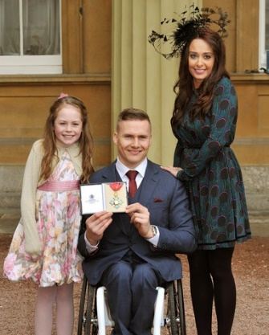
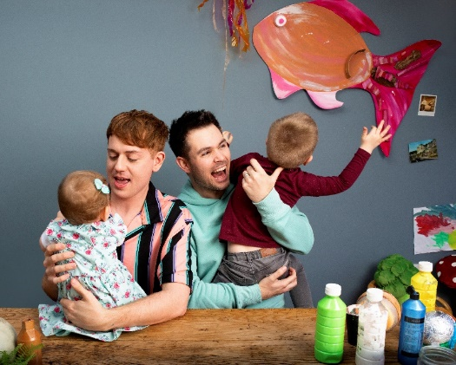
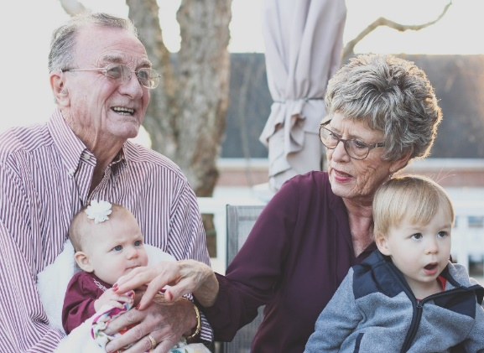
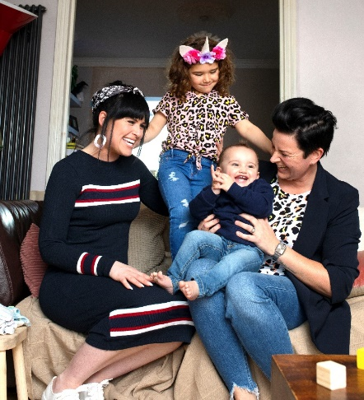
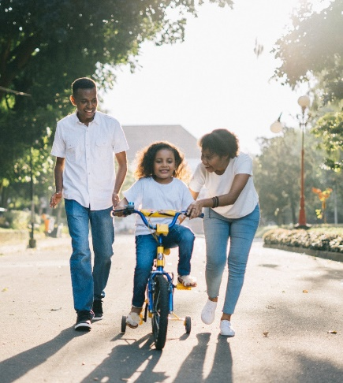
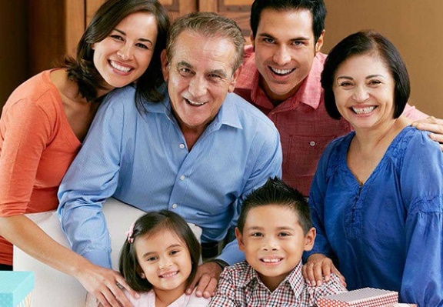
Notes:
What do all of these photos have in common? They show families
How are these families different to each other? Discuss the different types of family, including families with same gender parents, foster families, adoptive families (for example, Angelina Jolie’s family (see top left).
How are these families similar?

Slide 3
LO: To be able to share my opinions about the importance of family
What do all families have in common with each other?
What does a family need?
Notes:
Ask: What do families have in common with each other?
Think. Pair. Share.
Ask: What does a family need?
Think. Pair. Share.
Make sure you have discussed healthy family relationships – love, caring, support etc.

Slide 4
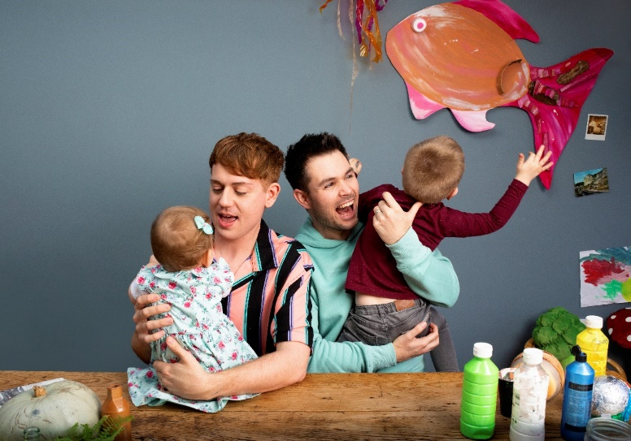
LO: To be able to share my opinions about the importance of family
Make a poster:
What does family mean to you?
Your poster needs to:
Include key words and phrases that answer the question
Show different types of family
Notes:
Ask children: What does family mean to you?
Children work in pairs or threes to make a poster about families. They should include some key words and phrases that show what family means to them (for example: love, togetherness, care, belonging). Their pictures should show different types of family.

Slide 5
LO: To be able to share my opinions about the importance of family
What does family mean to us?
Notes:
Visit a word cloud generation website, for example: www.wordclousds.com
Each child chooses a word from their poster and contributes it to the class word cloud. Add the words to the class word cloud.
Can children spot a common theme? Which words seemed most important to the class? Why might that be?

