Slide 1
Briefing for SENCOs - Sheffield Early Help Assessment form How the updated EH assessment form is now combined with the Extended Support Plan.
https://www.youtube.com/watch?v=S4m9sa1hZgg

Slide 2
Links with the Early Help assessment form
Sheffield has a new Early Help Assessment form designed to be the main assessment tool for the Sheffield Early Help System
There is a long-standing ambition to create one Early Help Assessment form to be used as the main assessment tool across the Sheffield Early Help System.
Following consultation with multi-agency partners, we now have a new form agreed and ready to use.
It will replace the FCAF, the Early Help Part 1 form and many other assessment and referral forms.

Slide 3
Why are we implementing a new Sheffield Early Help SEND Assessment form?
The SEND Graduated Response has evolved and improved over time, and this newest version is intended to combine the new Sheffield Early Help Assessment with the SEND Extended Support plan.
The Extended Support Plan sections are all contained within this updated form, just slightly rejigged into a different order, to fit with the Early Help assessment form requirements.
The new form is essentially the new Sheffield Early Help Assessment + a bolt-on extended support plan, where this is helpful.
Where an Extended Support Plan is required on it’s own, this form in its entirety will be used.
The new form incorporates;
the Signs of Safety Strength Based approach,
the Preparation for Adulthood Pillars,
the voice of the child(ren)
To prompt identification of significant life events that may be impacting a family, Young Carers, and contextual safeguarding factors.

Slide 4
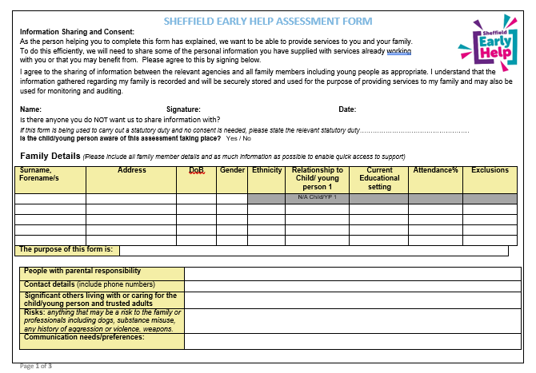
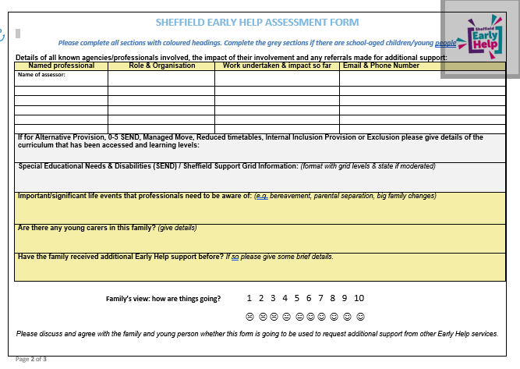
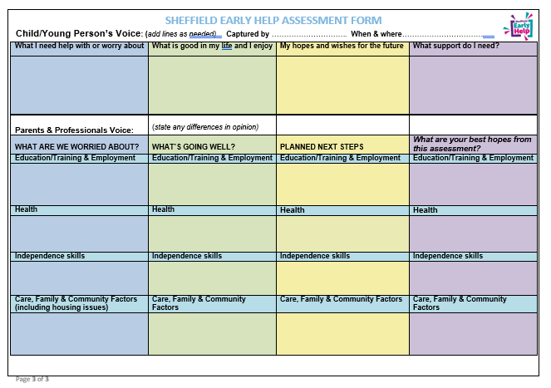
What are the changes?
The first section is the Early Help Assessment – a 3-page assessment form has been co-designed with multiple agencies to replace;
The FCAF
The Early Help Part 1 Form
The first section of the MyPlan/Extended Support plan
As many of the existing referral forms/routes to Early Help services as possible
The ‘Bolt-on’ Extended Support plan is essentially the current Extended support plan with any elements already covered by the Early Help Assessment removed.

Slide 5
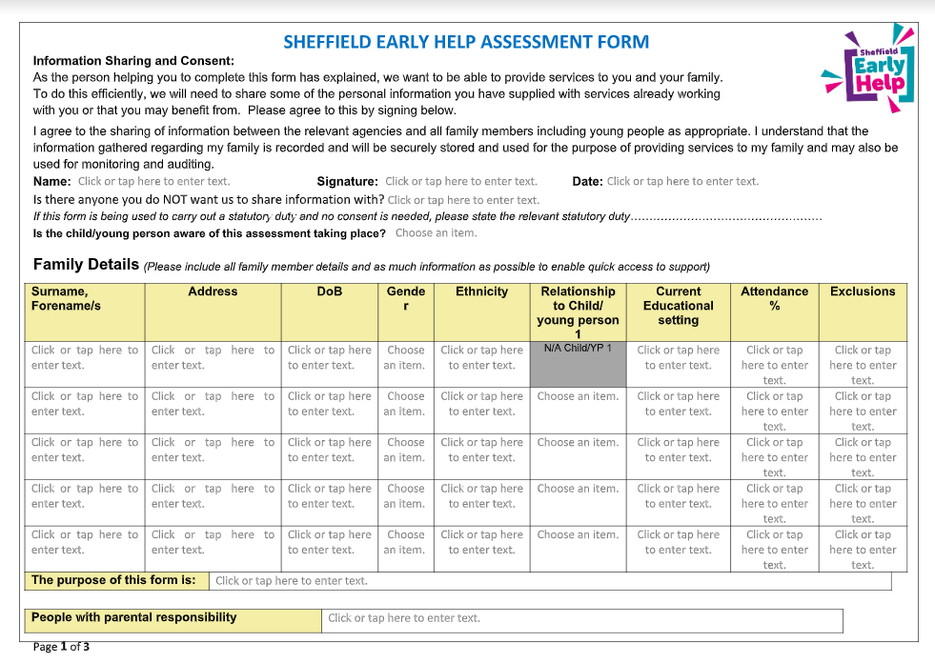
EH part 1 form

Slide 6
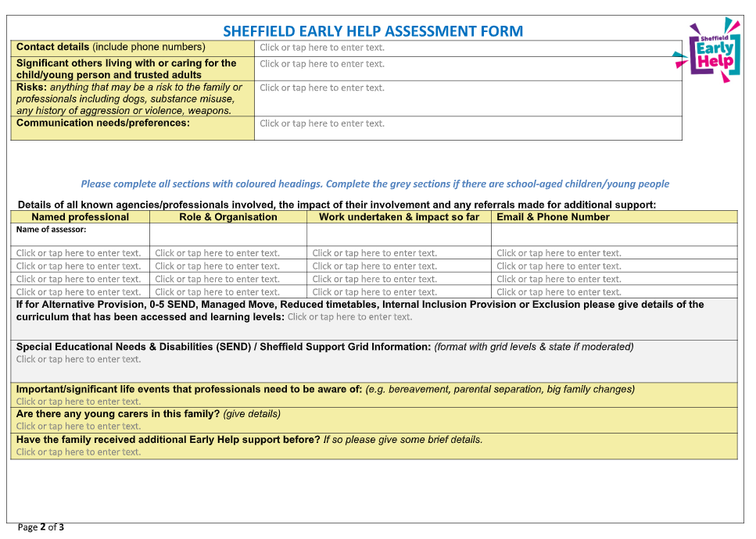

Slide 7
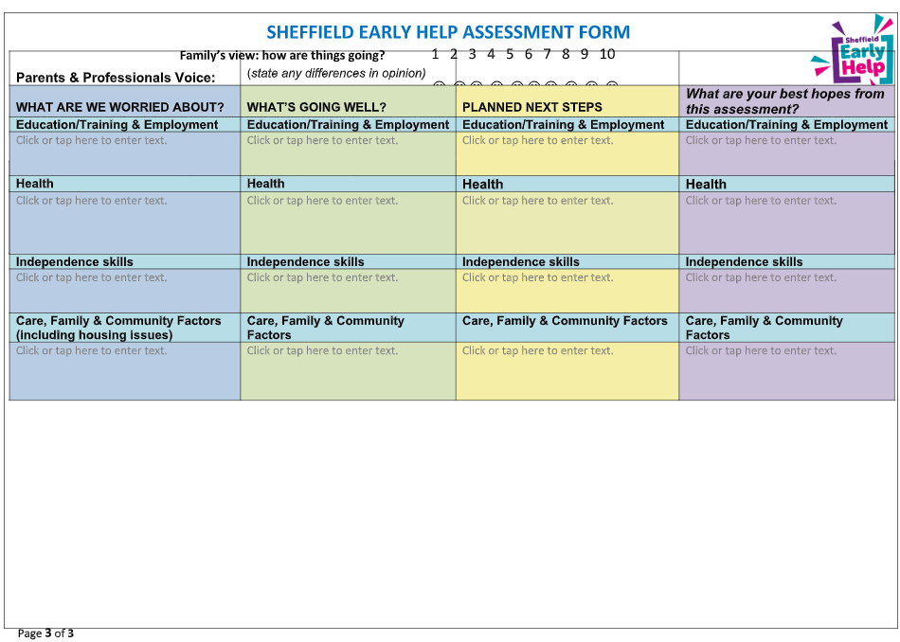

Slide 8
Who is the EH assessment form for?
Pastoral teams/learning mentors/staff supporting a referral for Early Help support will be expected to complete the Early Help assessment form. It can be submitted through the Early Help channels if support is being sought for the family.
SENCOs will be expected to use the Extended Support Plan as discussed in training sessions, for young people who would benefit from the more detailed document. The rejigged EXSP is available in its entirety on the Learn Sheffield website.
If an EXSP has been completed for a young person, it can of course be used as the Early Help referral if this is appropriate.

Slide 9
Purpose of the form
Information for Pastoral Teams/school staff completing the Early Help Assessment Form.
When you undertake this assessment, it is likely to be for a specific purpose. This may be for use by your agency only, to determine what additional support your agency may be able to offer the child, young person or family. Or you may be undertaking this assessment to explore what additional support may be needed from other Early Help Services.
Discuss your intended purpose with the family and state this on the form to ensure we have informed consent from the family.

Slide 10
How should it be completed
If you are working with a child, young person or family and you feel that they need additional support, then you are encouraged to work with the family to discuss their strengths and needs and to capture this in the Early Help Assessment form.
If the child or young person also has special educational needs or disabilities then the bolt-on extended support plan should also be completed.
You may feel that a Team Around the Family meeting would be helpful to discuss the strengths & needs, and gain the information needed to complete the assessment.

Slide 11
What to do with the completed assessment
Your next steps will depend on the level of need of the child/family.
The full Threshold of Need guidance and a short training video are available via the SCSP website:
Sheffield Children Safeguarding Partnership - Early Help, Thresholds of Need & FCAF (safeguardingsheffieldchildren.org)

Slide 12
Next steps…
Level 1: Universal Services
It may be that having completed the assessment you have established with the family that any additional support needs they have can be met by the agencies already involved with the family. In which case, you may feel that holding a review meeting with the family or Team Around the Family meeting in a few weeks time would be helpful.
Level 2: Getting Help
If the assessment process has established some emerging needs then you may find the additional service that can supplement the existing professional support network by looking at the Sheffield Directory Home Page | Sheffield (sheffielddirectory.org.uk)
Level 3: Targeted Support
If the assessment has revealed multiple complex issues then it is likely that a targeted Early Help support service will be needed. Discuss and gain consent from the family to send your assessment to EarlyHelpAssessment@sheffield.gov.uk and an Early Help specialist practitioner will recommend the right Early Help service to meet the needs of the family, in liaison with the family’s chosen support network and the professional support network.
Level 4: Statutory & Complex
If the assessment has made you concerned that a child is at risk of significant harm then you need to follow your agency’s safeguarding procedures.
Additional information at Sheffield Children Safeguarding Partnership - (safeguardingsheffieldchildren.org)

Slide 13
EXSP ‘bolt on’
The SEND Graduated Response will also build on the Early Help Assessment
The SEND Graduated Response is also evolving to incorporate the Early Help Assessment.
The Early Help SEND Assessment form can be a two-part document, with Part 1 being the new Early Help Assessment and Part 2 being the essential additional elements of the Extended Support plan. These can be used separately by staff in school or the combined EXSP form used, as appropriate for the young person.
Citywide SENCOs will be in touch with training dates and coaching sessions for locality SENCOs to support with this transition.
The documents will be available on the Learn Sheffield website as follows;
- Early Help Assessment form (part 1)
- The Support plan ‘bolt on’ section, where the rest of the EXSP needs adding to the EH assessment form.
- The EXSP as a whole document, where appropriate for a young person that would benefit from having the full document completed. This document is not required to be submitted for Early Help support, unless this is felt to be appropriate with the family.

Slide 14
Where do the sections from the EXSP sit now?
ESXP sections within the ‘Early Help’ form | EXSP within the ‘bolt on’ section of the form
Information sharing and consent Information about family members Contact details of person with parental responsibility Professionals supporting the family Child voice P4A section; Education, employment and training Health Independence Community and Friendships | CYP history and chronology – WITH IMPACT MEASURES Aspirations Locality SEND Support Support plan and reviews section

Slide 15
EXSP bolt on sections

Slide 18
For an Extended Support Plan…
You need to complete the full EXSP document, that is available on the Learn Sheffield website.

Slide 19
For an Annual Review…
You need to complete either both parts of the Early Help SEND Assessment referral form (the first 3 pages and the EXSP ‘bolt on’) AND the 2 page annual review document.
Or the EXSP and the 2 page annual review document as per the annual review training received.
Please come on the training sessions running at Learn Sheffield or link with your Locality SENCO for further information if you have any questions.

Slide 20
Sessions for support
Locality A | Tbc | Tbc
Locality B | Tbc | Tbc
Locality C | 13.12.23 4pm | 16.1.24 Network Meeting tbc
Locality D | 14.12.23 4pm | 29.1.24 4pm
Locality E | 14.12.23 4pm | 29.1.24 4pm
Locality F | Tbc | Tbc
Locality G | 18.12.23 4pm | 18.1.24 4pm
Special Schools | 14.12.23 10am | 17.1.24 10am

Slide 21
The benefits of the new Sheffield Early Help Assessment are;
Will reduce bureaucracy for frontline workers who identify additional support needs for children & families
The new assessment form should produce better quality referral information for targeted early help services
Families should not need to have multiple assessments to complete slightly different referral forms for early help provision – in line with Trauma Informed principles
More trauma informed design and with prompt to identify young carers and significant events impacting on the child/family.
Signs of Safety based format spanning education, health & care, family & community factors
Specific section for child’s voice including asking their view on their hopes & wishes for the future

Slide 22
Multi-agency training and a video briefing are available
You can view the 12 minute briefing video here: https://www.youtube.com/watch?v=S4m9sa1hZgg
Multi-agency Training on Early Help Assessment skills is available via the Early Help Partnership Training offer Early Help Workforce Training | Sheffield (sheffielddirectory.org.uk)
More information about the Early Help Assessment including guidance notes for completion and the Sheffield Threshold of Need guidance document is available here: Sheffield Children Safeguarding Partnership - Early Help, the Early Help Assessment & Thresholds of Need (safeguardingsheffieldchildren.org).
If you would like to request single-agency training on Early Help Assessment Skills for your organisation, please contact your link worker or link manager from the Family Intervention Service.

Slide 23
Implementation is from December 2023 to March 2024
From now until 31.3.24 Early Help services will accept both old referral form and the new Early Help Assessment. These should be sent to EarlyHelpAssessment@sheffield.gov.uk
Only the new Early Help Assessment to be accepted as the key referral document for most Early Help Services after 1.4.24.
For schools using the Extended Support plan as part of the graduated response to SEND, please start any new plans using the updated EXSP, which is available on the Learn Sheffield website. This should mean that the old templates naturally phase out over the academic year.
There has been fantastic feedback from practitioners in health, education and early help service who have tested using the new form and are ready to implement immediately – thank-you to all those who have given such positive feedback and enthusiasm for this.

