Slide 1
Preparation for Adulthood
Training for education providers and advisory services – Part 3
Academic year 2021/22

Slide 2
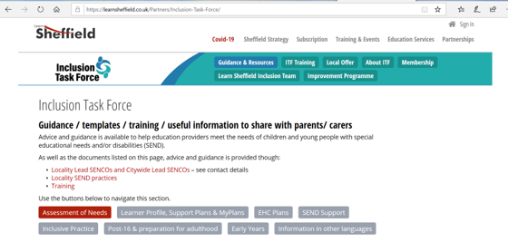
Introduction
Training builds on Annual Review training available on learnsheffield/Inclusion Taskforce website
Training delivered in 3 parts:
Training power point
Round table discussion
Further training and Q&A
Notes:
Meeting host to share slides / documents and spot light on presenters as needed in zoom throughout

Slide 3
Session aims
To explain why Preparation for Adulthood (PFA) is important
To consider best practice for supporting transition from age 14 into adult life
To explain what should be done each year from age 14 to the point a young person leaves formal full-time education
To consider the legal responsibilities and requirements on schools to support PFA for children with EHC Plans
To build on training on Annual Reviews of EHC plans
To consider how children at SEN Support and other vulnerabilities can be supported
To consider how health and care needs should be supported as part of PFA work
To answer questions that SENCOs and services have about PFA

Slide 4
Areas covered in this session
Aspirations
Outcomes
Transition meetings / Annual reviews from Year 9 onwards
Question & Answer

Slide 5
Developing aspirations
Part of transition planning
What is important to the young person in adult life? (what matters?)
What is important for the young person in adult life?
What is needed to get them there?
Aspirations may not be realistic but they’re still the young person’s aspiration – our job is to unpick them

Slide 6
Preparation for Adulthood outcomes
PfA outcomes don’t just start at 14 but outcomes focused on PfA should be embedded from Year 9 onwards – this means many outcomes will need to change and build on previous outcomes
Outcomes should be co-produced
Outcomes need to be important to and important for the young person
Outcomes should be SMART
Outcomes should focus on all 4 areas of PfA
Outcomes should focus on what needs to be achieved to be successful in entering adult life / leaving formal education
Steps towards outcomes are essential to help ensure success

Slide 7
Preparation for Adulthood outcomes
By the end of Year 12 James will be able to attend Rugby training once a week outside education in order to develop his friendships and independence.
Steps towards meeting the outcome:
James will know the day and time of Rugby training – provision needed to ensure he can tell the time and days of the week and has prompts to be able to find the time
James will remember his Rugby kit, including his boots – provision needed to help him plan for bringing his kit and reminders in order to do so
James will be able to wash his Rugby kit – provision needed to ensure he can clean his clothes and boots and bring them back the next week
James will be able to get home from training – provision needed to support James re travel training and understanding of the use of money for the bus, plus how to contact someone where he needs help
James will play Rugby safely and within the rules – provision needed to ensure that he is aware of the level of force he can and cannot use as part of training in line with his needs
James will be able to get help if he is hurt – provision to support him to communicate his needs
The provision needed may come from school, the Rugby club, the local authority or the family, however, it is important to break down the outcome to establish what individual parts are needed to help him to achieve the outcome. It should be noted that the skills he would gain from this outcome are transferable to other areas of life.

Slide 8
Preparation for Adulthood outcomes
By the end of Year 11 I will be able to get the bus too and from school independently each day in order to ensure that I can access college and my friends
Steps towards may then be about travel training support, building confidence, route planning, considering what are the best options for provision

Slide 9
Preparation for Adulthood outcomes
By the end of Year 10 I will be able to ask and answer a simple question when asked by an unknown person in order to ensure that I can be more independent and access the workplace
Steps towards may then be about work experience, training on communication skills, confidence building, support for social interaction

Slide 10
Preparation for Adulthood outcomes
By the age of 18 I will be able to remain safe during short periods without supervision and manage or contribute to my own basic care and living needs. I will become familiar with the concept of employment and will be able to identify areas of work that I may be interested in exploring. All this will ensure that I am able to become independent in life and work.
Steps towards may then be about work experience, reduced time with support worker, basic care needs, knowledge of living options

Slide 11
Preparation for Adulthood outcomes
By the end of my first year in post-16 education, I will be able to adapt to an unavoidable change in routine and structure, being able to communicate my concerns and seek help to prevent me becoming anxious.
Steps towards may then be about using coping strategies both in school and unfamiliar environments in order to prepare for this, work with college for him to identify support structures

Slide 12
EHC Plan / Transition Plan meetings – beforehand
The process through the year is essential to ensure the meeting can summarise the review
Administration – invites, time, length, location etc
Gathering the young person’s voice – person centred Parent participation
Involving services and future providers
Required paperwork
Notes:
Meeting summarises the review process that has been ongoing
Reference back to process documents provided in timeline slide – particularly focus on child and parent voice and why it’s important
Paperwork will be covered in round table in more detail
The process through the year is essential to ensure the meeting can summarise the review
Administration – invites, time, length, location etc
Gathering the child’s voice – how will they participate
Supporting the parent to access the meeting
Where a service is essential talk to them about why you want them there and how they can contribute
If substantial changes will be needed, for example placement, you must discuss this with assessment services in advance of the meeting
Consider the paperwork that is needed – current EHC plan to be annotated, Annual Review report, gathered evidence

Slide 13
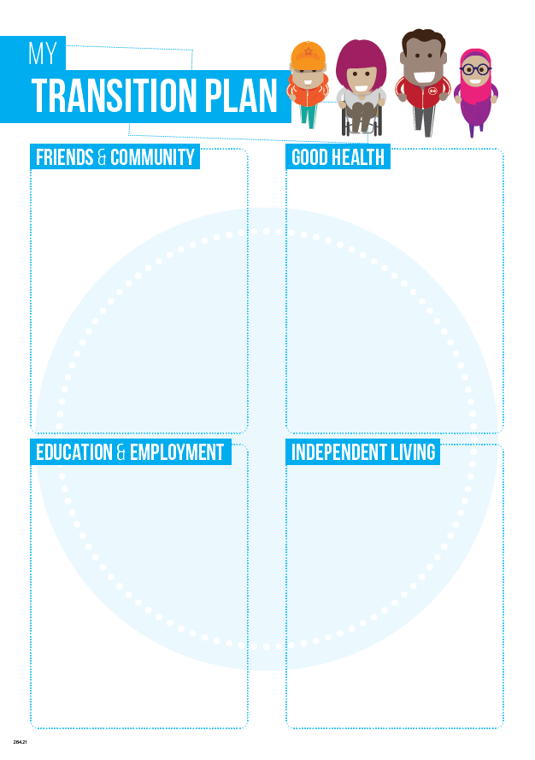

Slide 14
Annual Review meetings from Year 9
Person centred
Focus on the future
Lots of questions to cover at or in advance around 4 areas of need
p5wzjq0j636941293449773408.pdf (preparingforadulthood.org.uk)

Slide 15
Creating a post-16 ready EHC Plan
Concern from providers that too school focussed
Coherent reviews that identify changes and involve post-16 partners
Recognising specifics in provision – what is still relevant in post-16?
Outcomes that are updated regularly and plan for adult life
Transition plan forms part of annual review and should be used to make sure that EHC Plan is post-16 ready

Slide 16
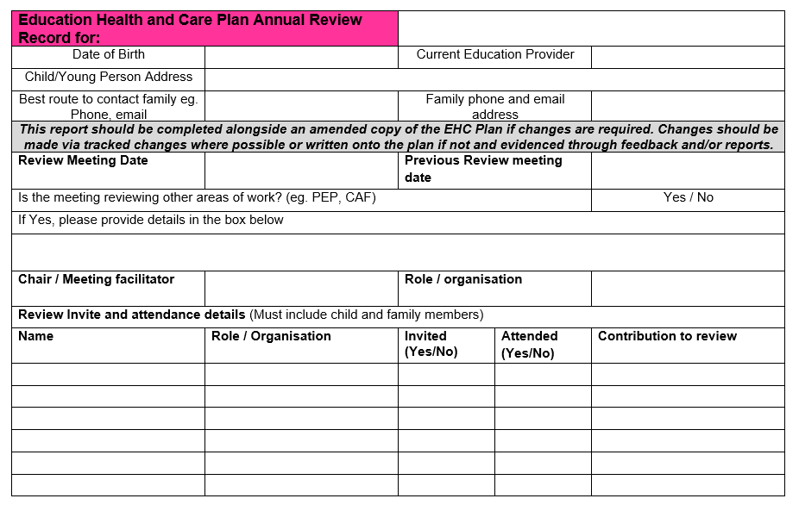

Slide 17
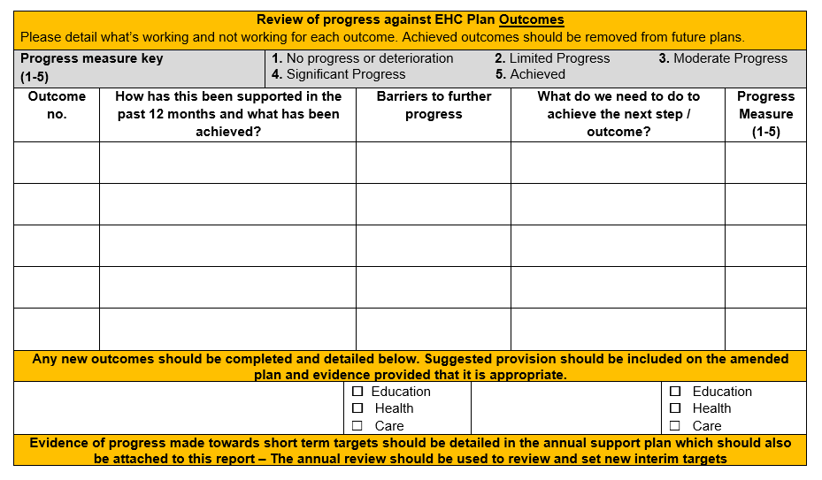

Slide 18
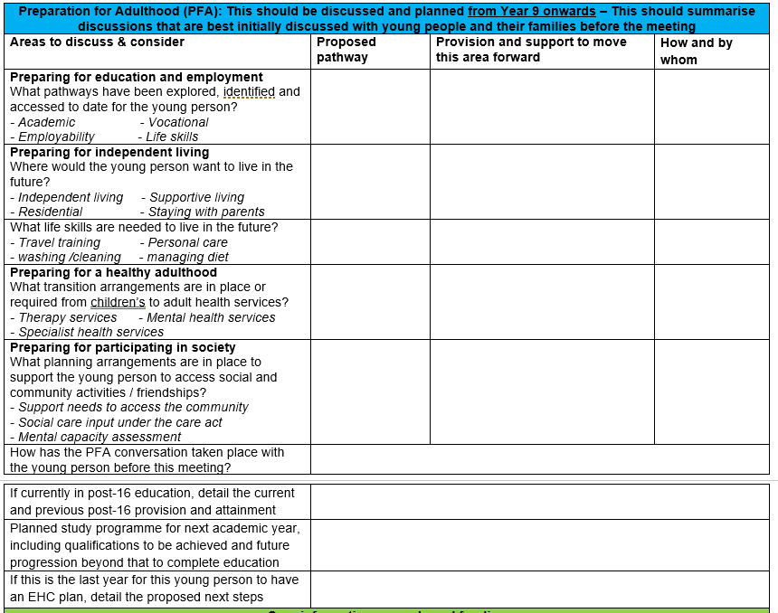

Slide 19
Consultation and commissioning
Effective early planning enables the local area to commission provision across Education, Health and Care
All plans must be amended to name provision for school leavers by the end of March
SCC requires time to consider commissioning requests and provide consultations to post-16 providers
Potential post-16 providers should be invited to Year 11 reviews to discuss provision in depth so that good transition can take place
Where a young person changes provision in post-16 education, the plan must be amended by end of March
Annual reviews should be scheduled to support this process
Should be able to see what further study intends to achieve, where it will lead and an end point

Slide 20
Remember it’s not just about preparing for post-16 education, it’s about preparing for adult life

Slide 21
Question & Answer session
Questions from these slides plus part 1 and 2 of training
5 minute breakout first – time to consider questions

