Slide 1
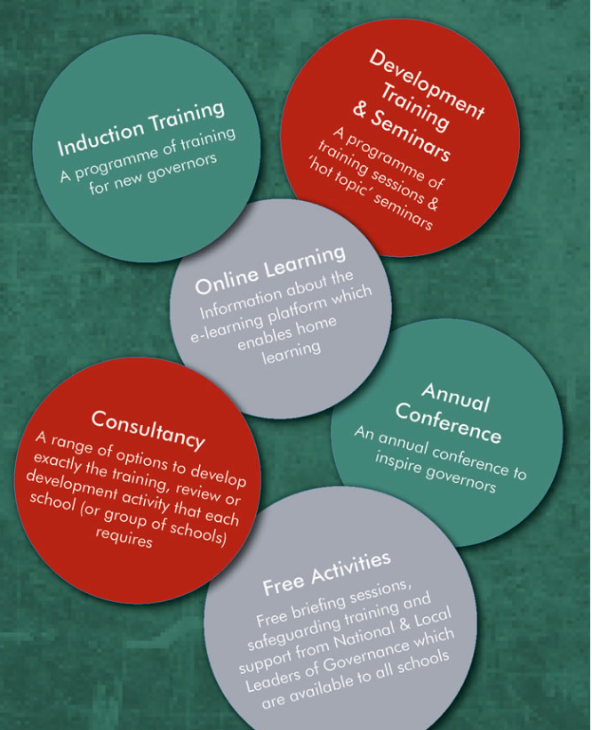
Governance Training 2018-2019
Notes:
This presentation has been provided for all schools/academies who either subscribe the Learn Sheffield Subscription Offer (which includes the Governance Training programme) or subscribe to the programme specifically.
The information on the following slides is an overview of the Governance Training programme.
It is designed to be shared with governors and trustees at relevant meetings in your school or academy setting and contains information about the programme, including what is on offer and how to book places.

Slide 2
Governance Training & Development Offer 2018/2019
This is the third year that we have published a Learn Sheffield Governance Training & Development Offer.
The 2018/2019 programme will again be delivered by a wide range of quality assured providers including, amongst others, The National Governance Association (NGA), Teaching Schools, National Leaders of Governance, Universities and Learn Sheffield’s own team.
We believe it constitutes an offer by the city to the city, and is an excellent example of Sheffield’s school led system at work.
The network programme is included in the Learn Sheffield Subscription, so any subscribing school can send a colleague to any network without any additional charge.
There is a cost for non-subscribing schools – information about this is available on the website.
All Governance training details are available on the Learn Sheffield website
http://www.learnsheffield.co.uk/Services-To-Schools/Governance-Training-2018-2019
Notes:
The delivery of the networks is commissioned to teaching schools and specialist providers – as described on the slide.
The programme is included within the Learn Sheffield Subscription or available at a cost to non-subscribing schools (£95 per session / £150 per conference ticket / £750 full access).
The Learn Sheffield website hosts the information about the programme – and is also the main way to book places.

Slide 3
Governance Training – Overview
The programme for 2018/19 includes:
Induction Training
Governance Training Courses
Termly Governance Briefings
Annual Governance Conference
Online Learning Package
Safeguarding Training (Sheffield Safeguarding Children’s Board)
Bespoke Training Information
Details are available on the Learn Sheffield website:
http://www.learnsheffield.co.uk/Services-To-Schools/Governance-Training-2018-2019
Notes:
These are the elements that make up the Governance Training offer.
The programme for 2018/19 includes:
Induction Training
Governance Training Courses
Termly Governance Briefings
Annual Governance Conference
Online Learning Package
Safeguarding Training (link to the Sheffield Safeguarding Children’s Board)
Bespoke Training Information
Each school/academy has unlimited places at each of these sessions but the places must be booked in advance.

Slide 4
Governance Training – How to Book
1. Click on ‘Services to Schools’
2. Click on Governance training
3. This will take you to the Governance training page which has buttons for each type of training.
Notes:
Follow the steps to access and book the training:
1. Click on ‘Services to Schools’
2. Click on Governance training
3. This will take you to the Governance training page which has buttons for each type of training.

Slide 5
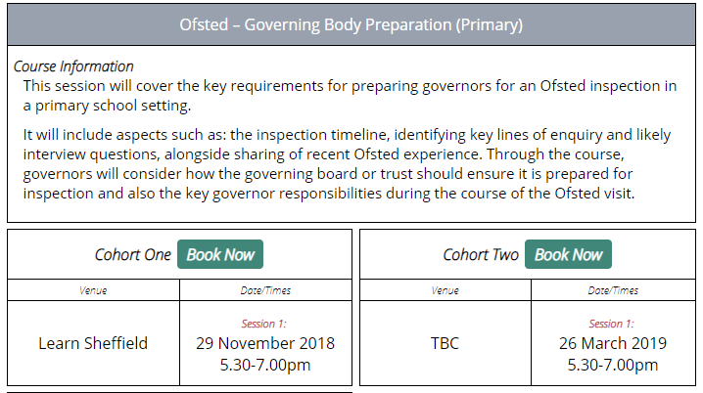
Governance Training – How to Book
Booking places for specific sessions is quick and easy.
We continue to use Eventbrite via the Learn Sheffield website which enables colleagues to find the session they wish to attend and book a place online.
They will then receive a confirmation email and a reminder prior to the training.
Information can also be accessed via Learn Sheffield, by phone (0114 250 7417) or by email (governance@learnsheffield.co.uk)
4. Click ‘Book Now’ for selected training
5. Click ‘Register’ to book
Notes:
The final steps in the booking process are:
4. Click ‘Book Now’ for selected training – each session or cohort (e.g. a series of sessions) can be booked in this way.
5. Click ‘Register’ to book – on the Eventbrite page in order to book the place.

Slide 6
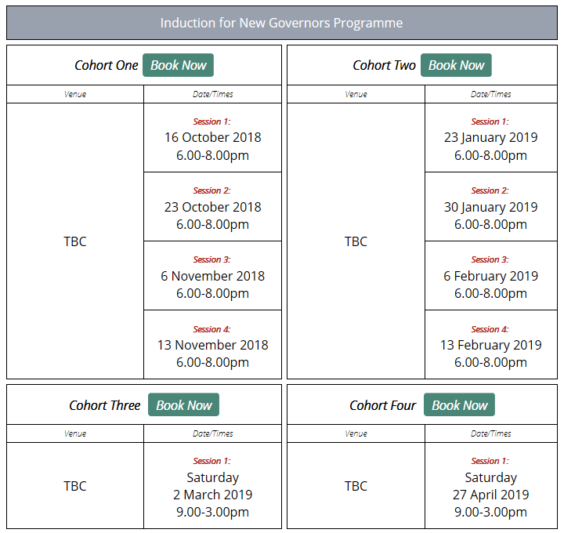
Governance Training – Induction Training
Click on Induction training button to access training dates
Induction training can either be accessed as four twilight sessions or a full day Saturday session.
Choose a cohort with the sessions that are structured in the way that works best for you.
Notes:
Induction training is available to support new governors and trustees.
Induction training can either be accessed as four twilight sessions or a full day Saturday session.
Colleagues should choose a cohort that is structured in the best way for them.

Slide 7
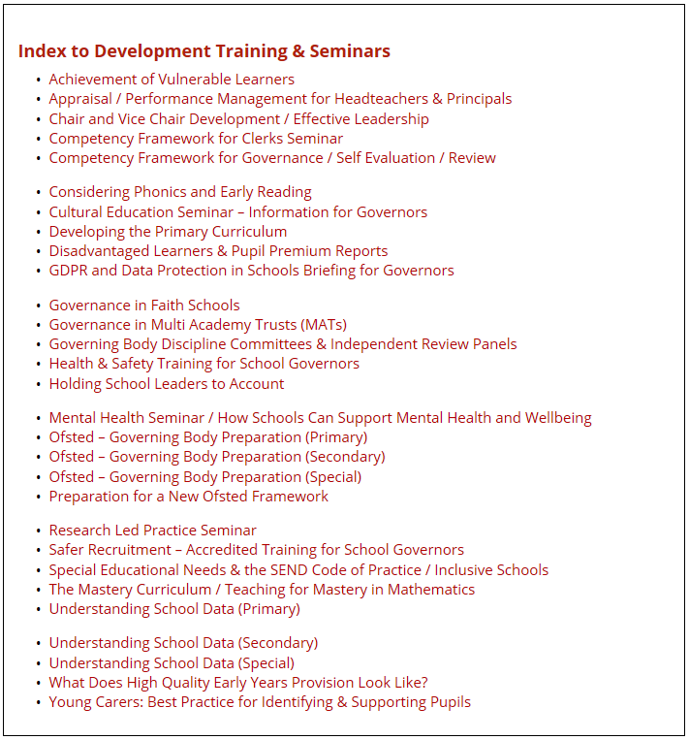
Governance Training – Training Courses
Click on Governor training courses to view and book
Course information can also be found in the training offer booklet
Clicking on the course in the index will take you directly to the course that you want to book
Notes:
The course information for all training courses can be found in the offer booklet and online … http://www.learnsheffield.co.uk/Services-To-Schools/Governance-Training-2018-2019
The index of courses lists the titles and also provides a way to ‘jump’ to that course in the list for booking.

Slide 8
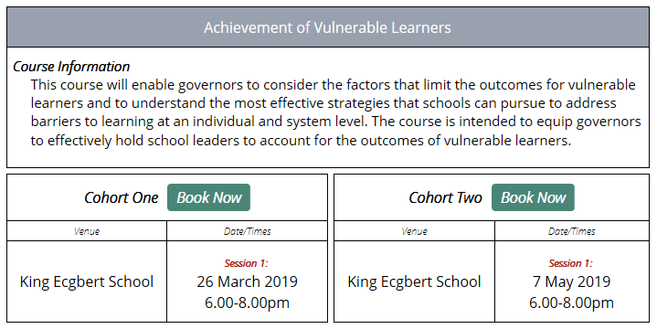
Governance Training – Training Courses
Each course contains course information which describes the purpose of the training
Click on the Book Now button to book a place on the cohort with the venue, date and time that works for you
Notes:
Each course contains course information which describes the purpose of the training.
Once you have identified the course, clicking on the Book Now button enables a place to be booked on the cohort with the venue, date and time that works for you

Slide 9
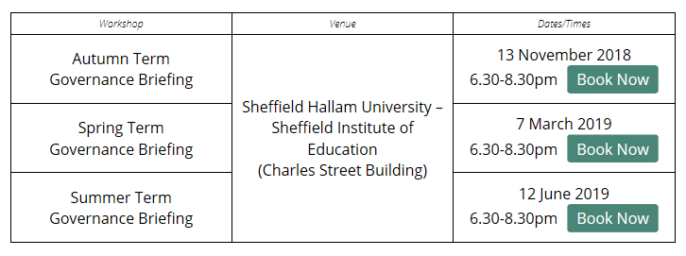
Governance Termly Briefing Sessions
Termly briefing sessions are free to all governors and trustees. They are designed to ensure that those involved in governance in Sheffield are well informed and supported.
When additional briefings are added, in the same way that Prevent briefings have been in the past for example, these will generally either be free or at a nominal additional cost.
Look out for emails and @learnsheffield tweets for information about the agenda of each briefing.
Click on the ‘Book Now’ button to book a place
Notes:
The dates of the three termly Governance Briefings for 2018-19 are on the slide.
The agenda for each briefing is sent out via email and through other communication channels closer to the date – for example via twitter, on the opportunities bulletin, etc.

Slide 10
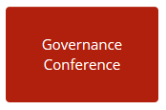
Governance Training – Annual Conference
Click on Governance Conference to access the information
The information about the 2018 Sheffield Governance Conference is online. The first keynote speaker has been announced – Emma Knights (CEO of the National Governance Association).
Each subscribing school has two tickets for the conference.
Notes:
The information about the 2018 Sheffield Governance Conference is online.
The question for the conference is ‘What are the key governance priorities now?’ and will seek to consider the priorities for governance at this pivotal time in education.
The first keynote speaker has been announced – Emma Knights (CEO of the National Governance Association). A second key note and the venue (which will be in the centre of Sheffield) will be confirmed soon.
Each subscribing school has two tickets for the conference (which will cost £150 each to non-subscribing schools).

Slide 11
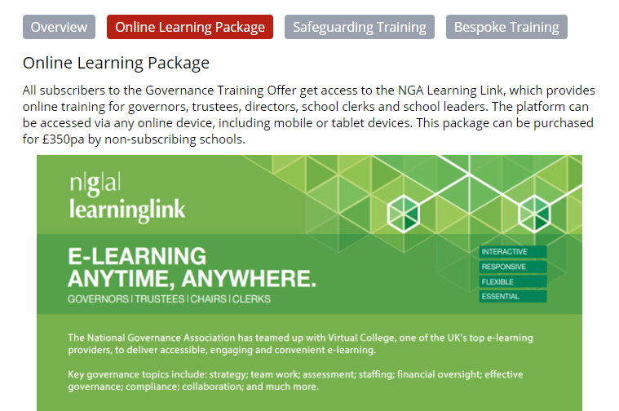
Governance Training – Online Learning Package
Click on Online Learning package to access the NGA link for online learning
Notes:
Our online learning package for governance is provided via the National Governors Association (NGA) ‘learninglink’, which they have developed in partnership with Virtual College.
This is included within the Governance Training package at no additional cost, but can be purchased separately by non-subscribing schools.
The training can be accessed via any online device and clicking on the link on the Learn Sheffield website provides information about registering to get login details.
It also includes where to go for support (in addition to Learn Sheffield) – www.nga.org.uk/learninglink … learninglink@ngaorg.uk … 0121 237 4600

Slide 12
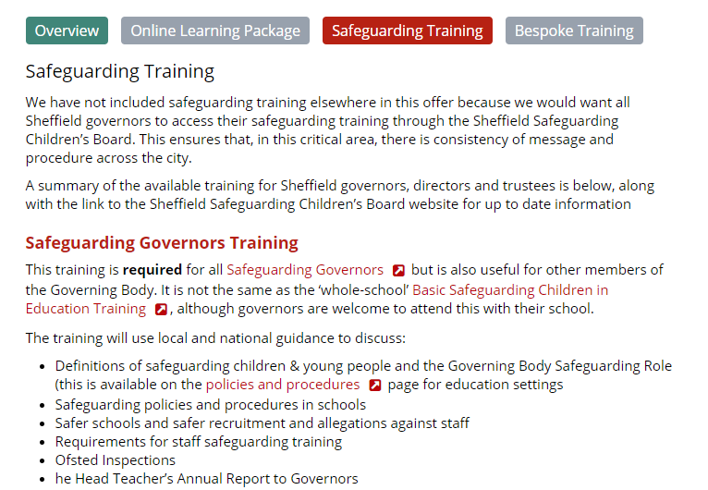
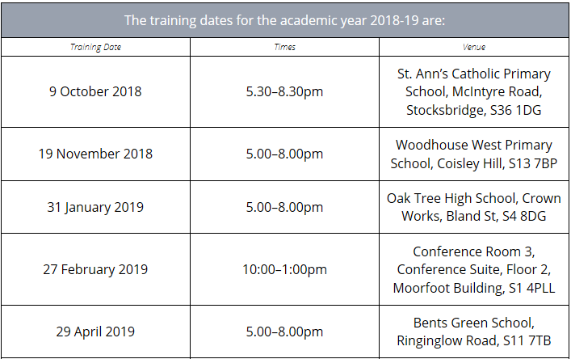
Governance Training – Safeguarding Training
Safeguarding training is provided by the Sheffield Safeguarding Children’s Board.
This ensures that there is consistency of message and procedure across the city.
Notes:
We have not included safeguarding training elsewhere in this offer because we would want all Sheffield governors to access their safeguarding training through the Sheffield Safeguarding Children’s Board.
This ensures that, in this critical area, there is consistency of message and procedure across the city.
The programme of training session for 2018-2019 is on the website along with the electronic booking form.

Slide 13
Governance Training – Bespoke Training
Click on the bespoke training button to see examples of how support can be offered and next steps
Bespoke training can include:
sessions from the booklet delivered on the school site
specially designed sessions developed to meet the training needs of the governors or trustees
coaching or mentoring for governors or trustees – often focussed on a specific purpose.
Notes:
Learn Sheffield can provide bespoke governance training for schools and academies – some examples are given on the slide.
This can include organising for a session in this booklet to be delivered on site or designing and delivering a bespoke session to meet the specific training needs of a governing body or trust boards. This bespoke training is not part of the subscription offer and will therefore carry an additional cost, with the price being dependent on the delivery required.
Learn Sheffield can also offer mentorship or consultancy packages to support the development of governance.

Slide 14
Governance Training 2018-2019
Notes:
For more information please visit the website or contact Learn Sheffield.

