Slide 1
Creating a Culture of Physical Activity in Sheffield
Prof. Robert Copeland C.Psychol,
Professor in Physical Activity & Health, National Centre for Sport and Exercise Medicine

Slide 2
London awarded 2012 Summer Olympic Games
Notes:
London was awarded the right to host the 2012 Olympic Games which brought extensive celebration across the UK - not just because we'd beaten the French at something - but because of what this could or might mean for the UK as a Sporting Nation.

Slide 3
Notes:
That really is the starting point for what has been my day job for the last couple of years and that is to establish the National Centre for Sport and Exercise Medicine in Sheffield.

Slide 4
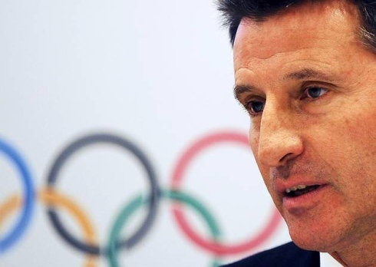
Our partners in East Midlands, London, and Sheffield will undertake world-class research and provide services that will deliver long-term systematic change to benefit the health of the nation.
Lord Seb Coe
9 January 2012

Slide 5
NCSEM Sheffield Partners
Notes:
If you are looking to implement new pathways or technologies then you will need partners and we have all these partners sat round the table in Sheffield
Truly a city-wide project

Slide 6
NCSEM-Sheffield Vision
To create a culture of physical activity that results in Sheffield becoming the most active city in the UK by 2020

Slide 7
NCSEM-Sheffield Mission
Make it easier for everyone in Sheffield to be active everyday.
Notes:
We also recognized that this was about Making it easier for everyone in Sheffield to be active as part of everyday life
Which meant providing the opportunity, environment and human capital to be sufficiently physically active to benefit their health and wealth.

Slide 8
Notes:
That was then translated into a 5-year plan under the banner Move More which has 6 outcomes that we want to achieve:
Empowered communities
Active Environments
Active people and families
Activity as medicine
Active schools
Active workplaces.
Focus quickly on the Activity as medicine outcome as this is what was funded by DH.

Slide 10
Challenge Overview
Mass participation event to engage the City in Physical activity and Showcase the existing work in Sheffield.
Month of July 2016 pre Olympic Games
Engage at least 50,000 people in physical activity
Engage at least 5,000 people currently inactive
Launch the Move More app for physical activity monitoring
Raise awareness & increase signposting to physical activity

Slide 11
Move More Celebration
Mixture of ‘free-to-access’ physical activity tasters and opportunities and physical activity challenges
City-wide challenges
(e.g. Sheffield United vs. Sheffield Wednesday)
Community challenges
(e.g. local groups, teams or parks)
Workplace challenges
(e.g. active travel challenges, work-based walking)
School challenges
(e.g. active travel challenges, classroom and play-based challenges)

Slide 12
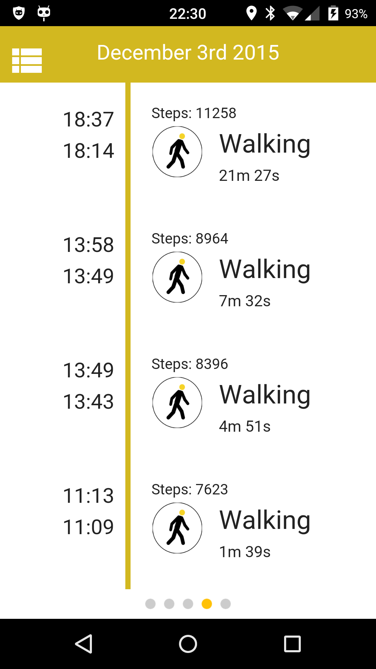
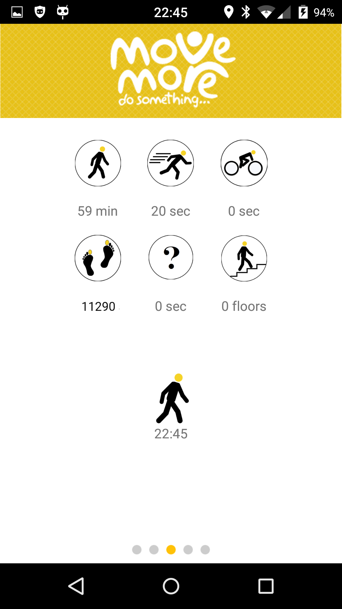
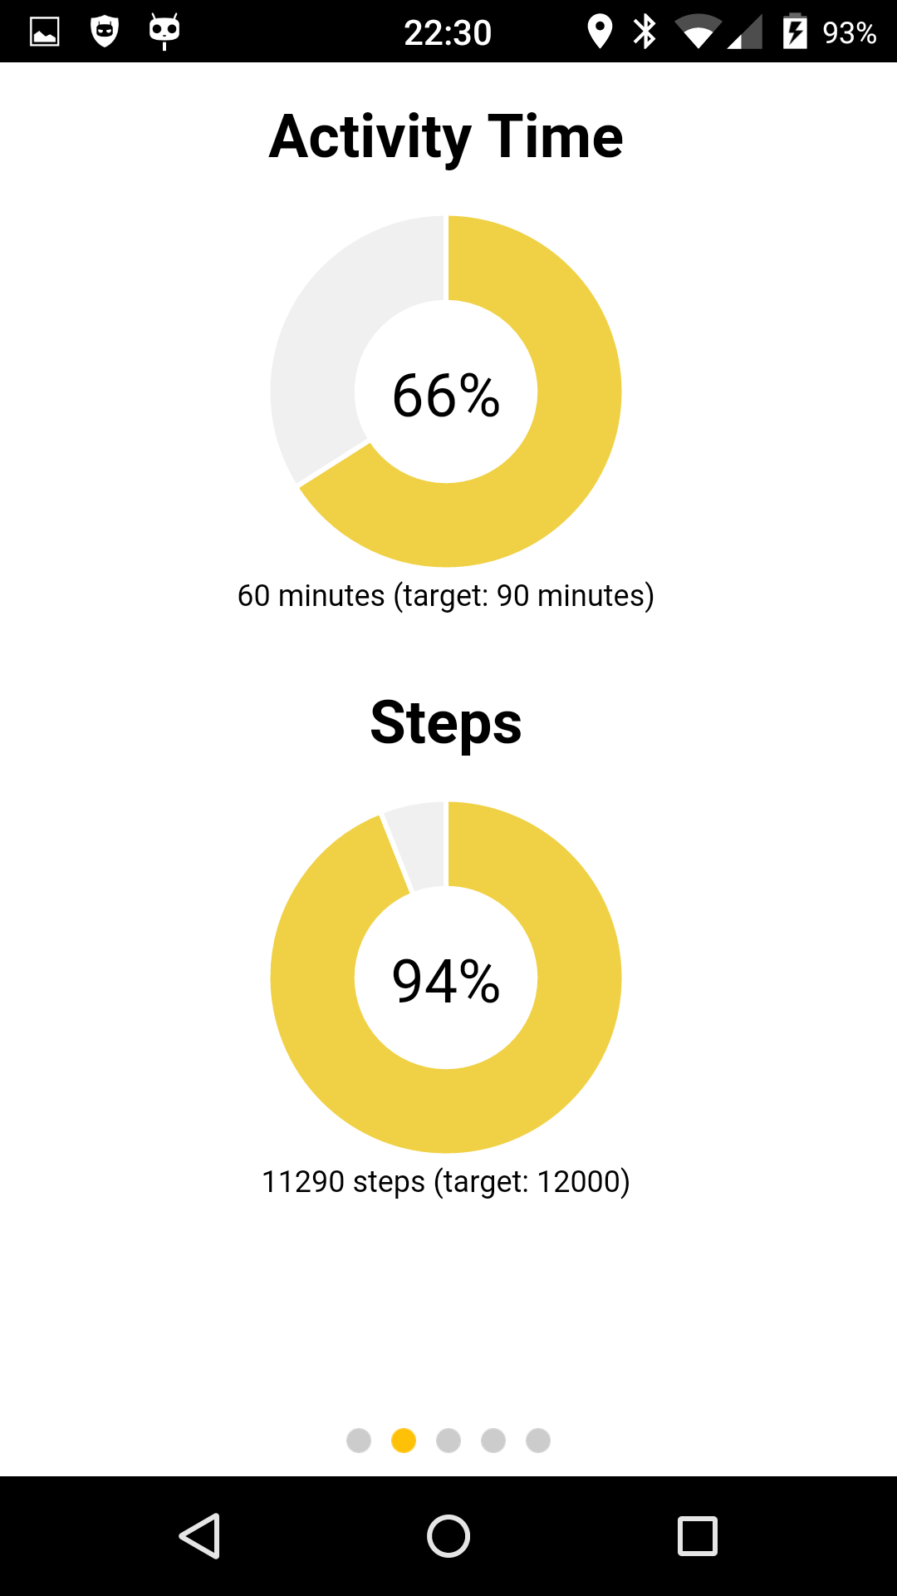
Powered by the Move More App

Slide 13
Supported by RFID Technology

Slide 14
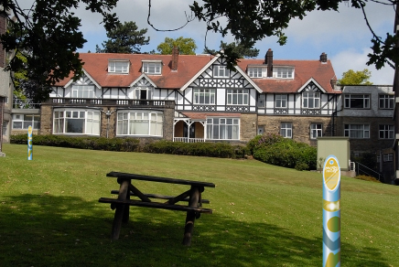
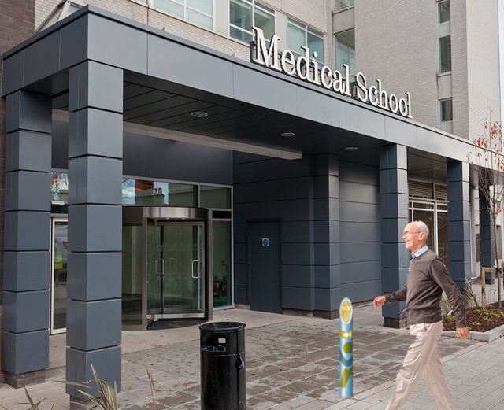
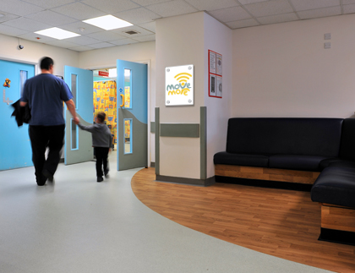
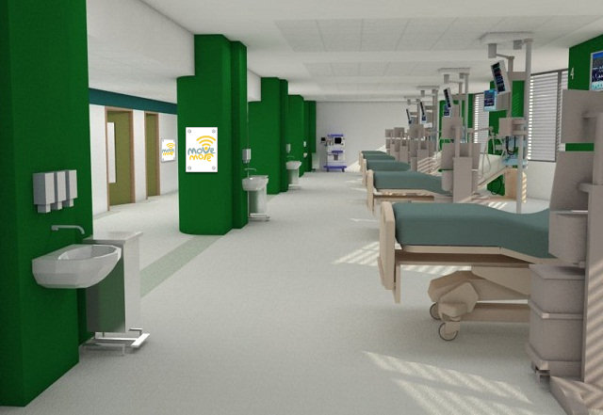
Move More Challenges

Slide 15
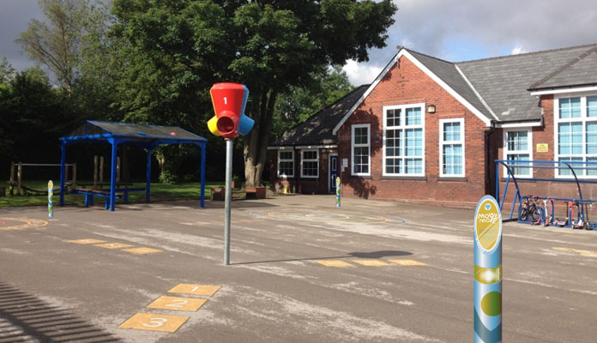
Move More Challenges

Slide 16
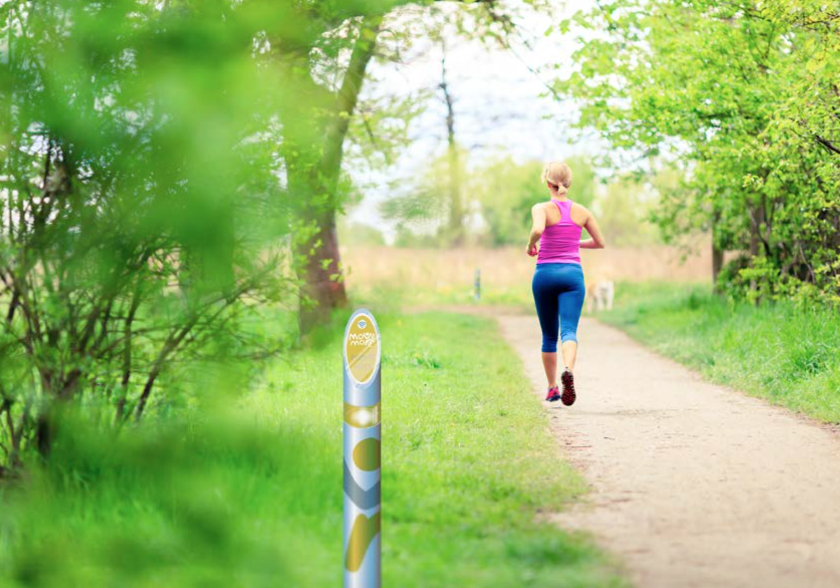
Move More Challenges

Slide 17
Move More Website as the Hub
Via a personalised page on the Move More website and/or the Move More app, each participant will be able to see:
Their own progress (minutes of activity each day- moderate/ vigorous)
The overall progress of the city in terms of activity
The progress of any team they have signed up to (in relation to their competitors)
Options to sign-up to challenges

Slide 18
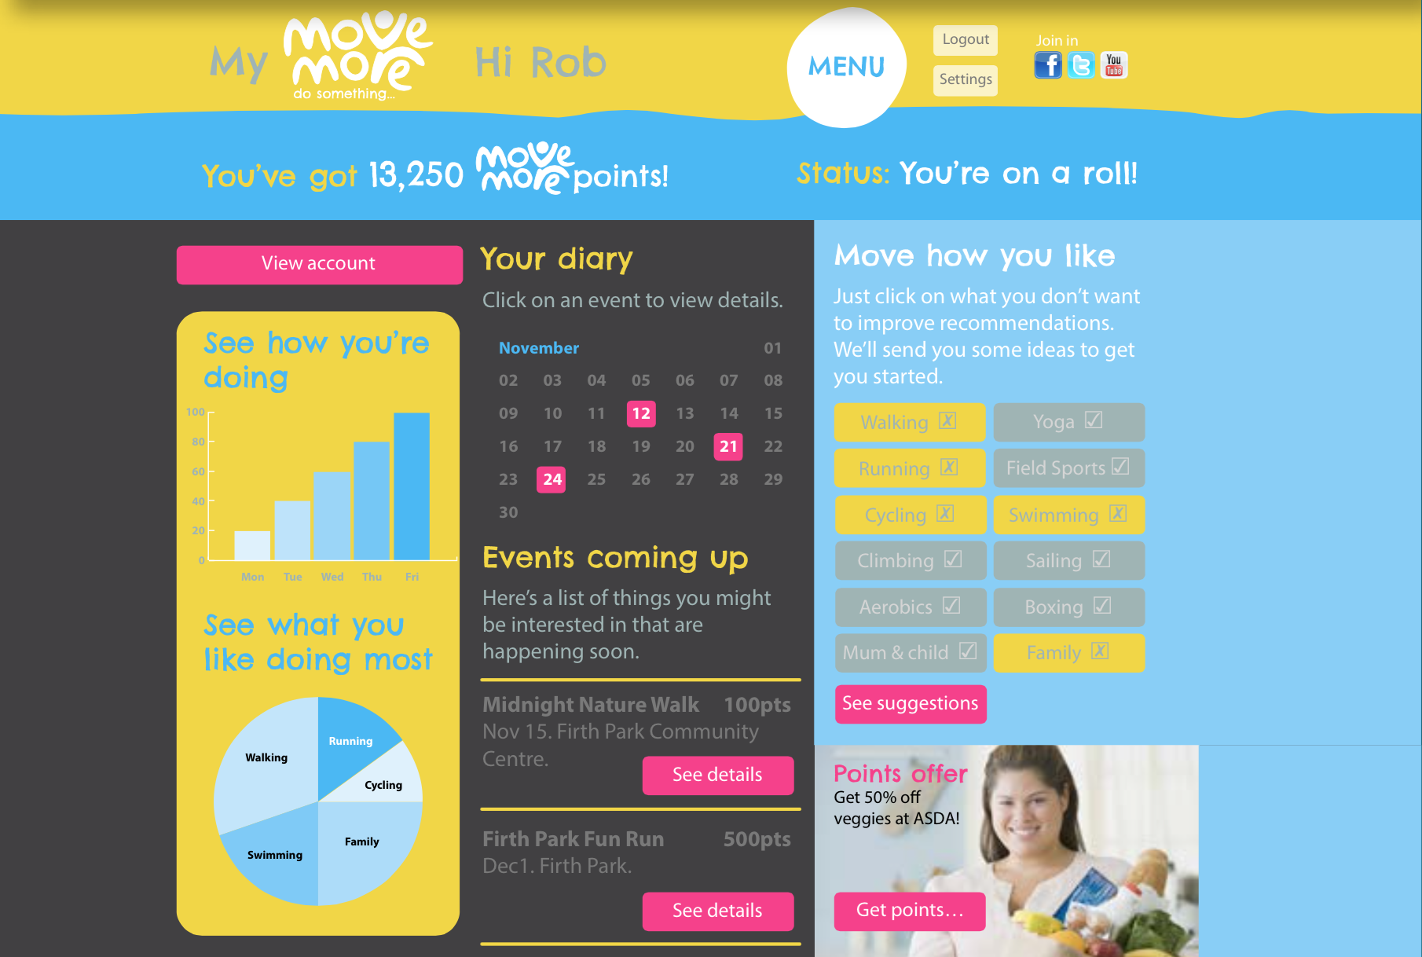
Move More Website as the Hub

Slide 19
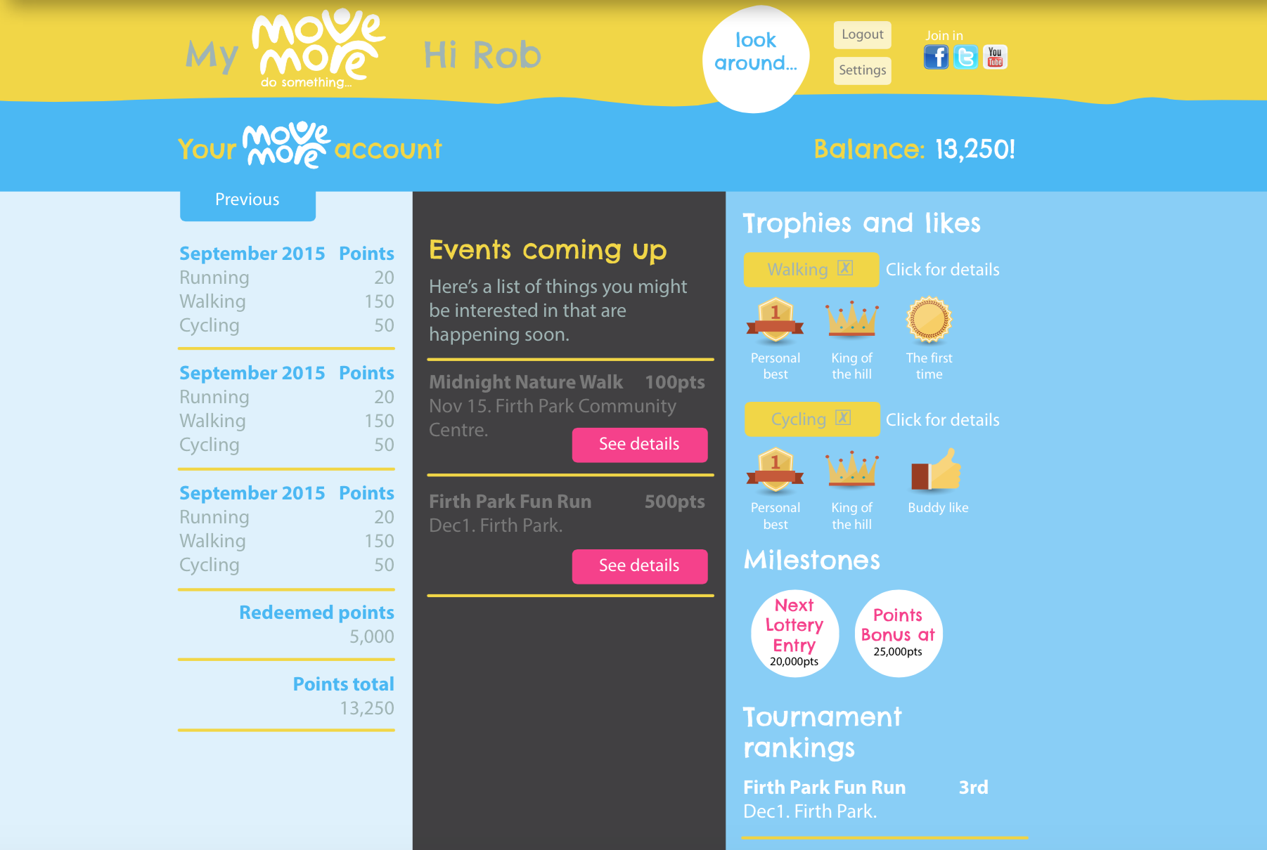
Move More Website as the Hub

Slide 20
3 Asks of You
To become part of the Move More Challenge by working with us to develop the ‘physical activity challenges’
Run a challenge in your school in July using the resources we will provide
Become a champion for physical activity across the city

Slide 21
Contact details
Prof. Robert Copeland C.Psychol
Project Manager NCSEM-Sheffield
r.j.copeland@shu.ac.uk
@DrRobCopeland
Web: www.shu.ac.uk/research/cses/
www.movemoresheffield.com
Notes:
Many thanks for your attention.

